Slide 1
IDE Website
https://trimas.id/
Coconutrate Home

Slide 2











HOME
ABOUT
SOLUTIONS
PRODUCTS
PROJECTS
CONTACT US
Clients

Slide 3
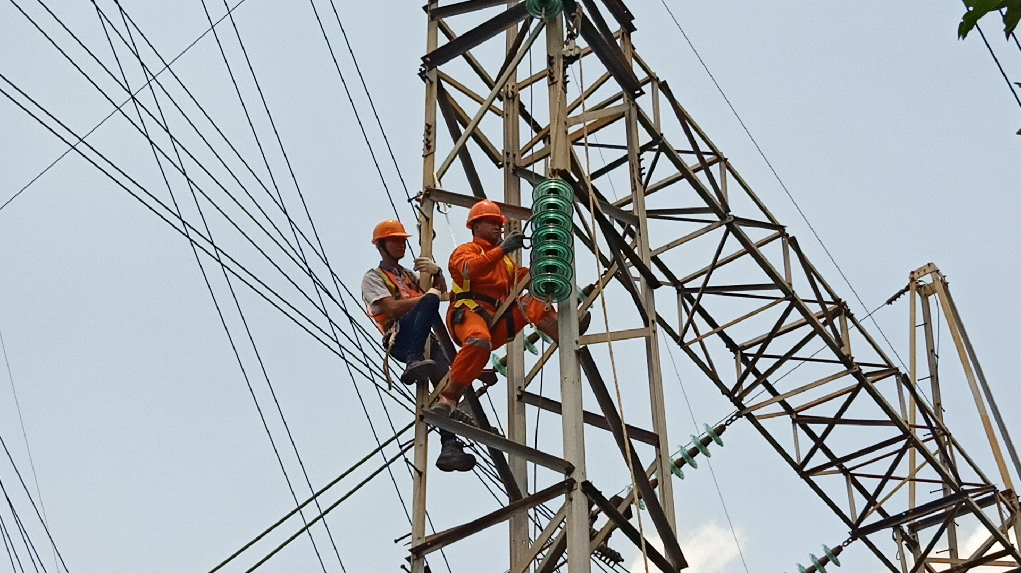
Slide Show
Image : 001_Slide Substation.jpg
SUBSTATION AND
ELECTRICAL SERVICES
LEARN MORE

Slide 4

Slide Show
Image : 002_Slide EVCharger.jpg
ELECTRIC VEHICLE
CHARGER (SPKLU)
LEARN MORE

Slide 5
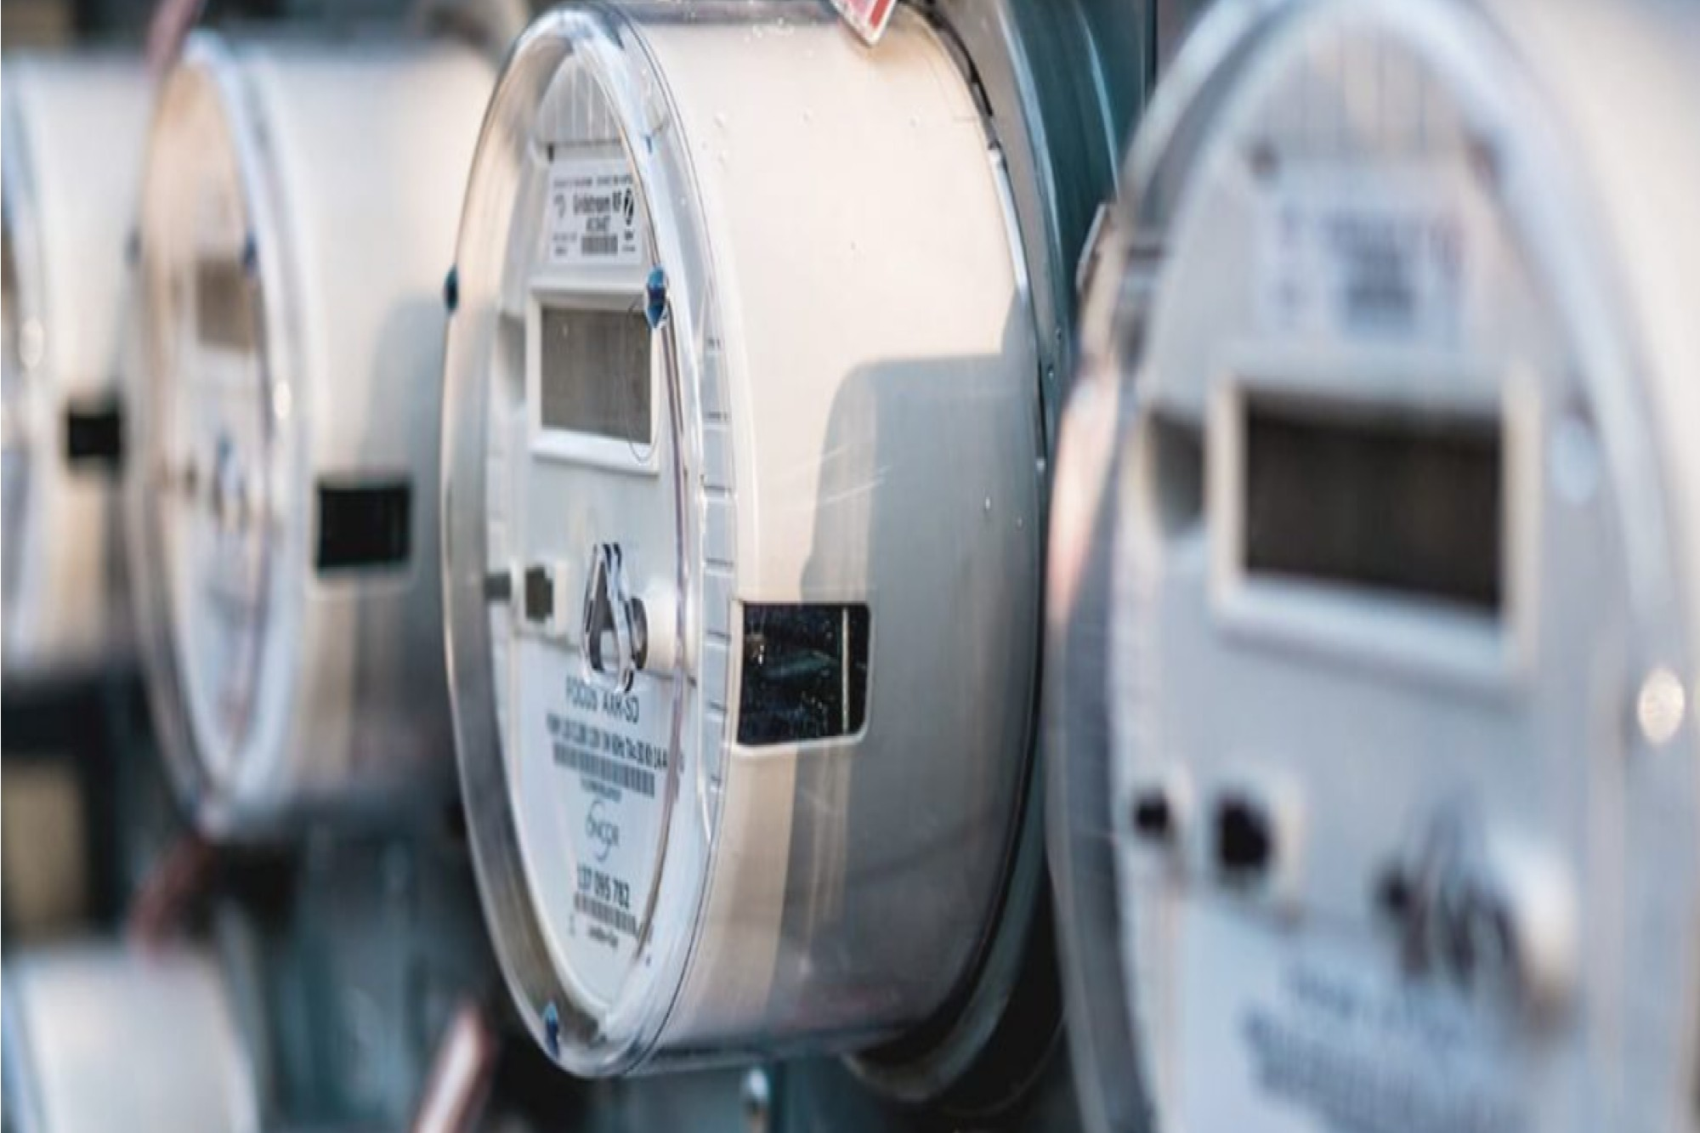
Slide Show
Image : 003_Slide energy environment Management.jpg
ENERGY & ENVIRONMENT
MANAGEMENT
LEARN MORE

Slide 6
HOME
ABOUT
SOLUTIONS
PRODUCTS
PROJECTS
CONTACT US
ABOUT
Line of Business
Vision and Mission
The Management
Address
Certificates
SBUJPTL, IUJPTL, SBUJK
SMK3, CSMS
AHLI K3
LINE OF BUSINESS
PT SINERGI RODIKA UTAMA is Mechanical & Electrical contractors and Supplier in a wide variety of commercial and industrial projects :
Substation, Backup power supply, Scada and Automation,
Electric Vehicle Charger (SPKLU)
Energy (Electricity, water and gas) & Environment Management.
PT SINERGI RODIKA UTAMA has become an proven partner of PT PLN (persero) and other commercial industrial sectors handling Substation, Transmission and Distribution projects since 2011
Our commitment to professional excellence has enabled us to achieve, often even exceeds, our client expectations. With efficient utilization of human and technical resources has been proven to complete projects within the designated time frame and budgets with speed, safety, cost effectiveness, and professional technicians

Slide 7
HOME
ABOUT
SOLUTIONS
PRODUCTS
PROJECTS
CONTACT US
ABOUT
Line of Business
Vision and Mission
The Management
Address
Certificates
SBUJPTL, IUJPTL, SBUJK
SMK3, CSMS
AHLI K3
VISION
“To become a professional, competitive and competent company in the field of electrical and mechanical supply and services with the best and accountable services”.
MISSION
To provide a good product and Service with excellent technical support
Being a good corporate citizen must be given the highest priority.
Take a mutual understanding and interest among vendors and clients Developing a business with an efficient, effective and targeted process

Slide 8
HOME
ABOUT
SOLUTIONS
PRODUCTS
PROJECTS
CONTACT US
ABOUT
Line of Business
Vision and Mission
The Management
Address
Certificates
SBUJPTL, IUJPTL, SBUJK
SMK3, CSMS
AHLI K3
THE MANAGEMENT
Commissioner: Mr. Fathoni and Director: Mr. Ikman Tri Putra
ADDRESS
Office : Ruko Renata, Jl. Jalur Sutera Timur Kav. 6A No. 16 Alam Sutera
Tangerang BANTEN 15144
Telp/Fax 021 22352886
Email : sales@sinergirodika.co.id Website : www.sinergirodika.co.id

Slide 9
HOME
ABOUT
SOLUTIONS
PRODUCTS
PROJECTS
CONTACT US
A. Akta Pendirian PT
a. Nomor Akta: 20
b. Tanggal : 23 February 2011
c. Nama Notaris : MIRA OKTARIA, S.H, MKn
B. Nomor Induk Berusaha (NIB)
Nomor: 9120000210357
Tanggal: 03 June 2022
Bidang Usaha: Pengadaan Barang dan Jasa Mekanikal Elektrikal
Issued by Balai Sertifikasi Elektronik
C. Sertifikat ISO 9001
No Certificate:DTQMS1057
Date :11 Desember 2017
Valid until :10 Desember 2027
Issued by : Define Equality Veritas
D. FINANCE RECOGNATION BY DNB
D&B Rating 3A3
Financial Strength 3A Based on tangible net
worth of IDR 3,600,000,000 to IDR 17,999,999,999
Risk Definition 3 Sufficient capacity for meeting payment liabilities
Valid until :30 June 2025
Issued by : Dun & Bradstreet (DnB)
ABOUT
Line of Business
Vision and Mission
The Management
Address
Certificates
SBUJPTL, IUJPTL, SBUJK
SMK3, CSMS
AHLI K3

Slide 10
HOME
ABOUT
SOLUTIONS
PRODUCTS
PROJECTS
CONTACT US
ABOUT
Line of Business
Vision and Mission
The Management
Address
Certificates
SBUJPTL, IUJPTL, SBUJK
SMK3, CSMS
AHLI K3
A. Sertifikat Badan Usaha Jasa Penunjang Tenaga Listrik (SBUJPTL)
No Certificate : 329.1.8.211.M.3C.3674.B20
No Registration : 0329.02.B20
Date : 25 Februari 2020
Valid until : 25 Februari 2025
Issued by : PT Sertifikasi Badan Usaha Mandiri
Jenis Usaha : Pembangunan dan Pemasangan Instalasi Penyediaan Tenaga Listrik
Bidang : Transmisi Tenaga Listrik
Sub Bidang : Gardu Induk
Kualifikasi : Menengah
B. Sertifikat Ijin Usaha Jasa Penunjang Tenaga Listrik (IUJPTL)
No Certificate : 671.1/04-DESDM.IUJPTL/I/2023
Date : 20 Januari 2023
Valid until : 20 Januari 2028
Issued by : Dinas Energi dan Sumber Daya Mineral Provinsi Banten
Jenis Usaha : Pembangunan dan Pemasangan Instalasi Penyediaan Tenaga Listrik
Bidang : Transmisi Tenaga Listrik
Sub Bidang : Gardu Induk
Kualifikasi : Menengah
C. Sertifikat Badan Usaha Konstruksi (SBUJK)
No Certificate :PB-UMKU : 912000021035700070001
Date : 12 September 2023
Valid until : 11 September 2026
Issued by : Balai Sertifikasi Elektronik
Jenis Usaha : Pekerjaan Konstruksi
Bidang : Konstruksi
Sub Bidang : Konstruksi Bangunan Sipil Elektrikal dan Konstruksi Gedung Lainnya
Kualifikasi : Kecil

Slide 11
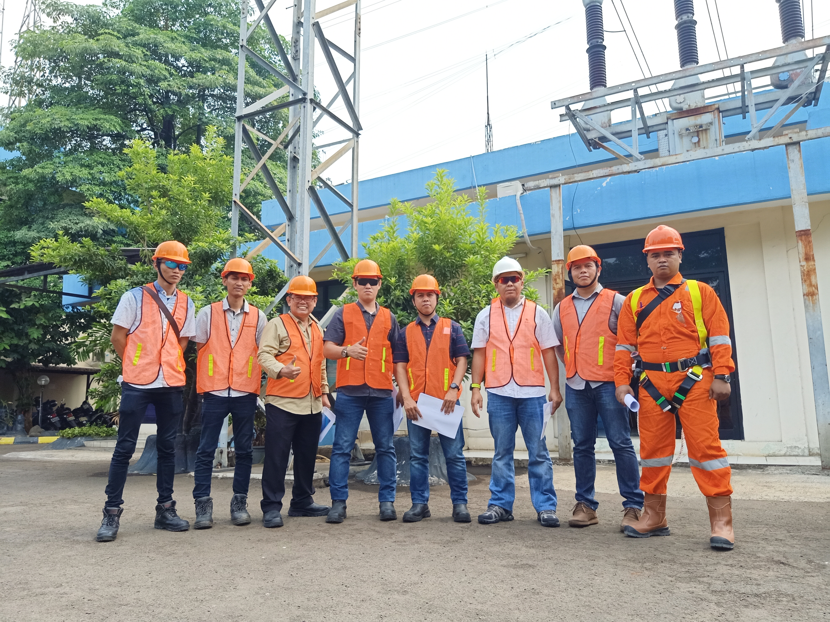
HOME
ABOUT
SOLUTIONS
PRODUCTS
PROJECTS
CONTACT US
Image : 005_Sinergi Team.jpg
A. Sertifikat Manajemen Keselamatan dan Kesehatan Kerja (SMK3)
No Certificate: SMK3.2020.MAL.SK.968
Date :09 June 2023
Valid until : 09 June 2026
Issued by :Kementerian Ketenagakerjaan
B. SERTIFIKAT CONTRACTOR SAFETY MANAGEMENT SYSTEM (CSMS)
No Certificate : 001402/DIST/CSMS/IX/2022
Date 23 September 2022
CSMS Criteria : Sangat Tinggi
Valid until: 24 September 2025
Issued by: PT PLN (Persero) UP3 Serpong
C. AHLI K3 UMUM
No Certificate: 0053050923/Q-AK3U/36/IX/2023
Date : 5 September 2023
Atas Nama : Ansar
Valid until : 5 September 2026
D. AHLI K3 LISTRIK
No Certificate : 5/1116/AS.02.04/III/2020
Date : 13 March 2020
Atas Nama : Supratman
Valid until : 21 March 2026
ABOUT
Line of Business
Vision and Mission
The Management
Address
Certificates
SBUJPTL, IUJPTL, SBUJK
SMK3, CSMS, AHLI K3
PT Sinergi Rodika Field Team

Slide 12
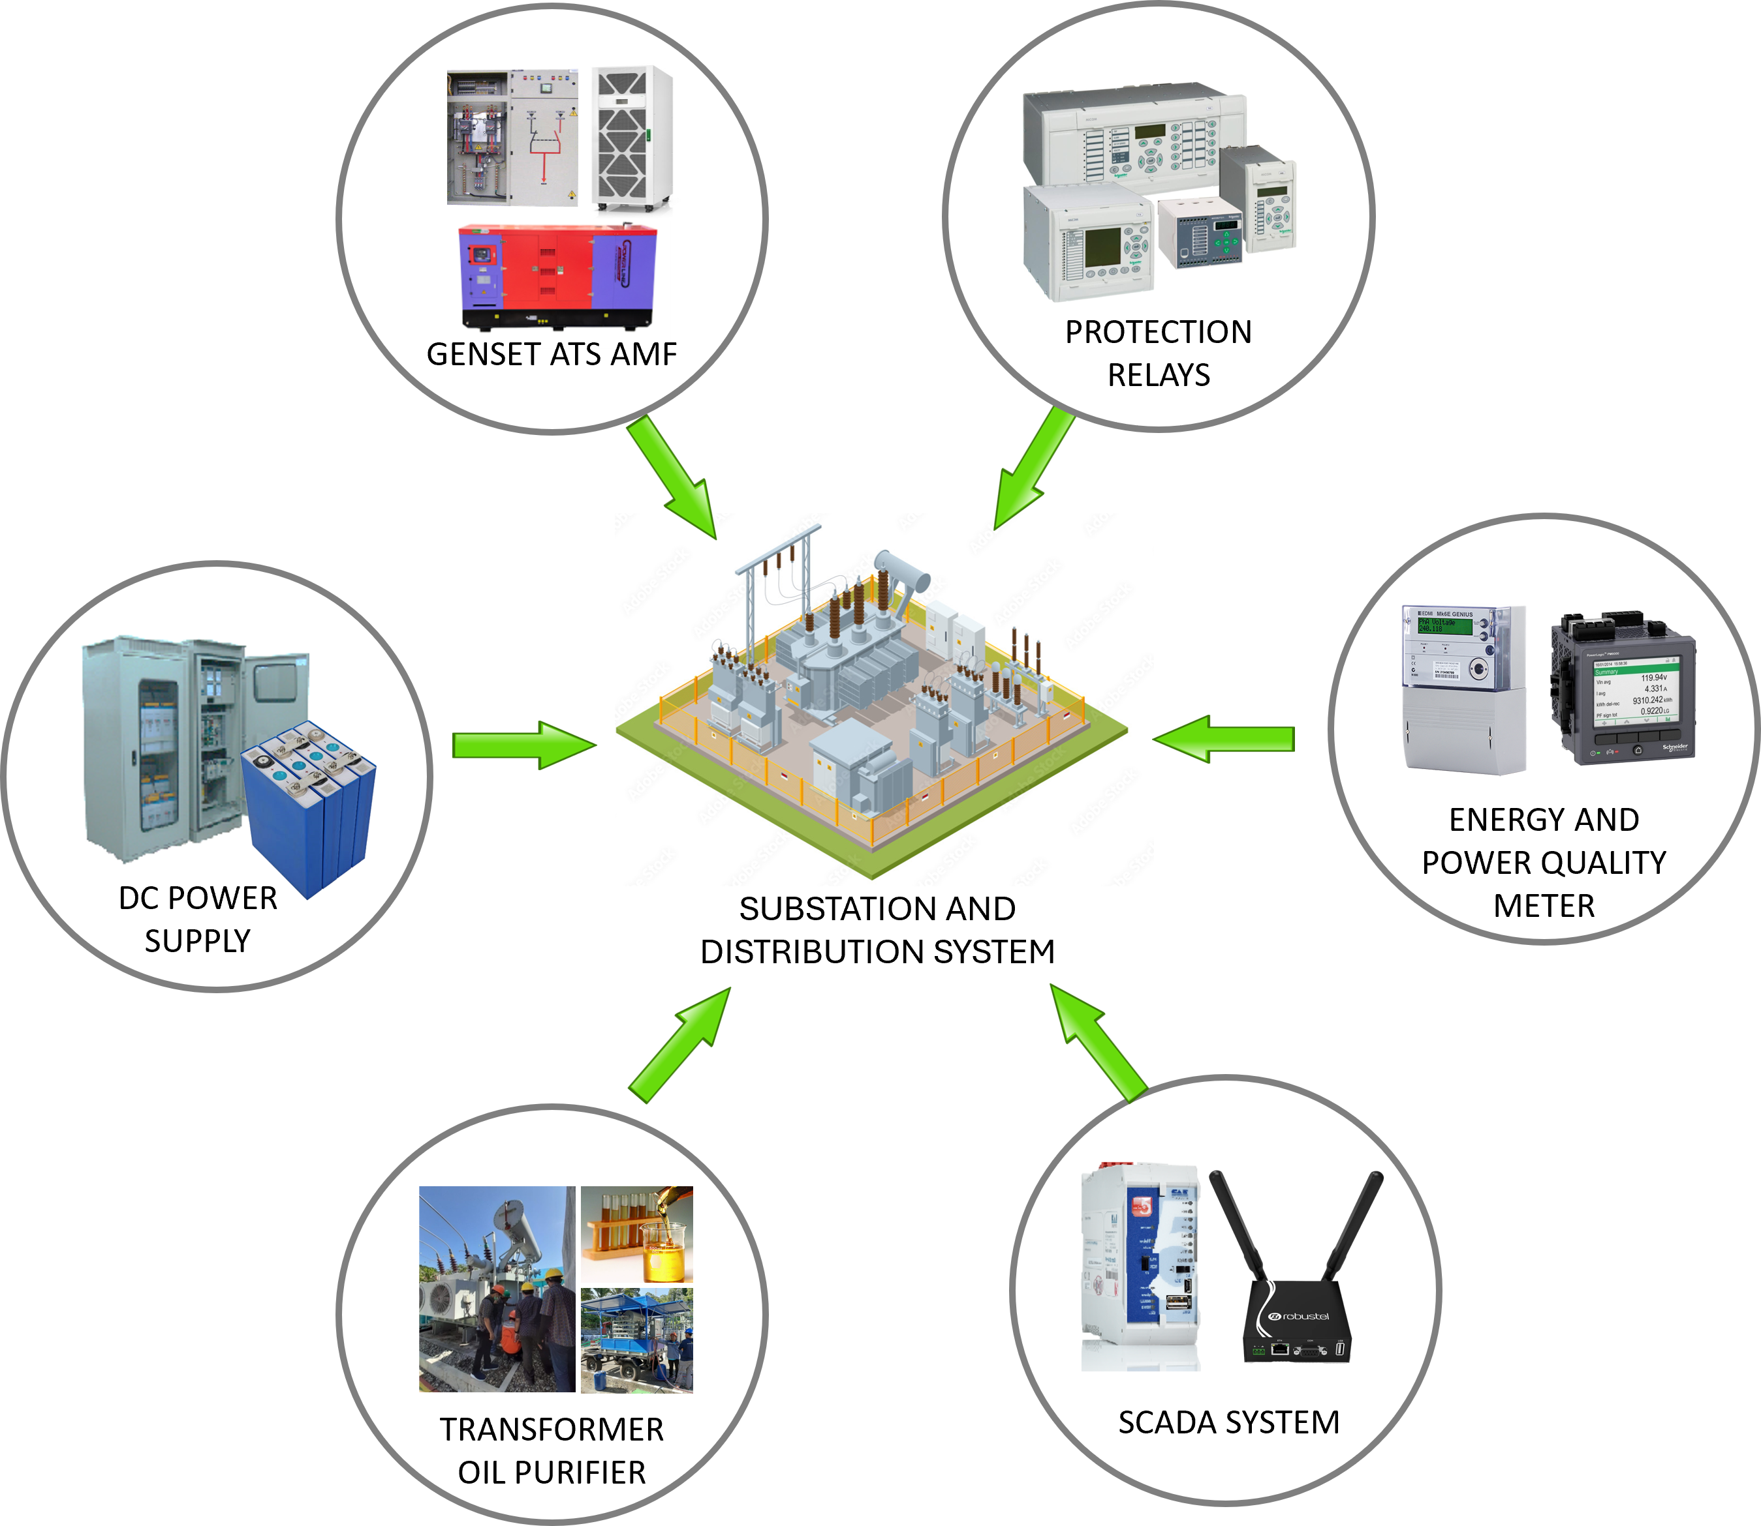
HOME
ABOUT
SOLUTIONS
PRODUCTS
PROJECTS
CONTACT US
Electrical Service
Electric Vehicle Charger (SPKLU)
ENERGY AND ENVIRONMENT MANAGEMENT
Relay Protection : Over current/ Ground Fault,
Transformer Differential, Line Current Differential,
Under Frequency Relay
More>> Projects Ref
More >> Product
Generator set, ATS AMF and UPS as Substation backup
power when main power disappear,
Generator operates automatically controlled by ATS AMF to
supply the electricity to Substation
More >> Projects Ref
More >> Product
Energy metering : Kwh meter Class 0.2s and 0.5,
Power Quality monitoring, Voltage dip/Sag/swell,
More >> Projects Ref
More >> Product
Scada System : Key point control, monitor and analyze
via means of media and protocol communication and
temperature sensor for early warning system
More >> Projects Ref
More >> Product
DC power supply : Rectifier 24/48/110 VDC,
Inverter DC/220VAC, Battery LifePO4
More >> Projects Ref
More >> Product
Transformer Oil Purifier to improve insulation oil by removing
trace water, gas, particulate matters etc. to boost performance
and life time of transformers, circuit breakers, mutual inductors
and cable with Capacity : 2000, 4000, 6000 liter/hour
based on size of transformer
More >> Projects Ref More >> Product
SOLUTIONS
ELECTRICAL SERVICE
Relay Protection
Generator ATS AMF
Energy Metering
Scada System
DC Power Supply
Transformer Oil Purifier
ELECTRIC VEHICLE CHARGER (SPKLU)
ENERGY AND ENVIRONMENT MANAGEMENT
Energy Monitoring for Utilities
Street Lighting
CCTV
Water/ Flood Monitoring
Image 006_Electrical Service Scheme.jpg

Slide 13
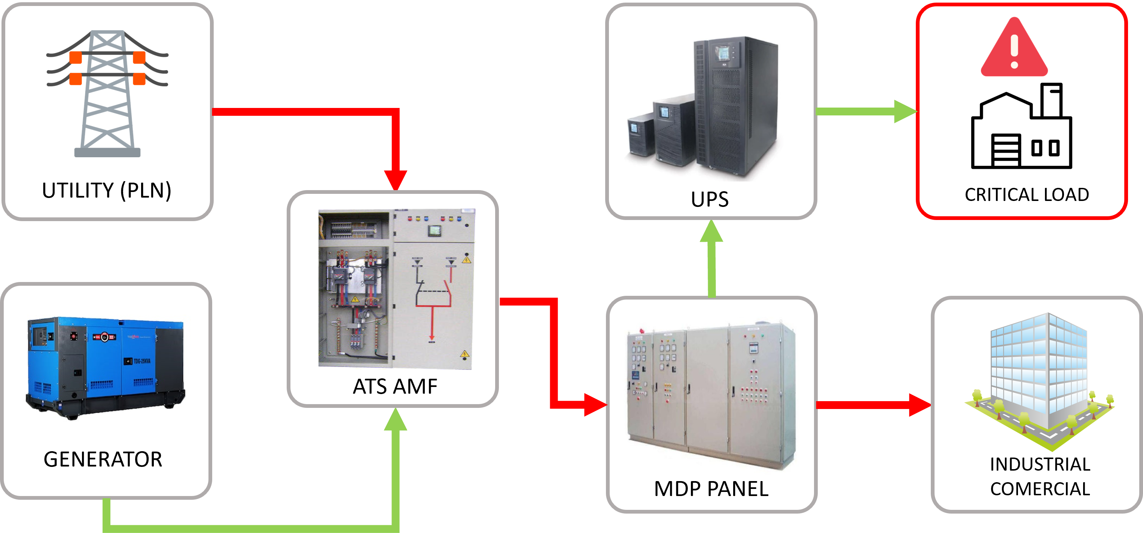
GENSET + AMF BACKUP POWER SUPPLY
HOME
ABOUT
SOLUTIONS
PRODUCTS
PROJECTS
CONTACT US
Image : 007_Genset Scheme.jpg
SOLUTIONS
ELECTRICAL SERVICE
Relay Protection
Generator ATS AMF
Energy Metering
Scada System
DC Power Supply
Transformer Oil Purifier
ELECTRIC VEHICLE CHARGER (SPKLU)
ENERGY AND ENVIRONMENT MANAGEMENT
Energy Monitoring for Utilities
Street Lighting
CCTV
Water/ Flood Monitoring
GENERATOR SET
Supply and New Installation as main or backup power supply, Ranging from 25-2500 kVA, Open or Silent type to Mobile Trailer option.
Comprehensive Genset Services: Includes routine maintenance, General Overhaul (GOH), and Top Overhaul (TOH) for ensuring optimal genset performance and lifespan.
Customized Repair Solutions: Providing expert repair services for a broad range of genset models, ensuring rapid response and minimized downtime.
Energy Consultancy: Offering professional advice on energy management and efficiency, helping businesses optimize their energy use and reduce costs.
ATS & UPS
Electrical Installations: Comprehensive services for the installation and maintenance of electricity infrastructure, including connections to PLN and necessary installation using Automatic Transfer System ATS AMF with automatic running when the power our from PLN and back to main when back to normal
Wide range of capacity Uninterrupted Power Supply (UPS) to provide continuous power from the internal battery until utility power returns to safe levels or the battery is fully discharged for critical installation like Hospital, IT Servers, Traffic management, Cellular providers BTS, etc
>> More Project Reference >> More Product Detail

Slide 14
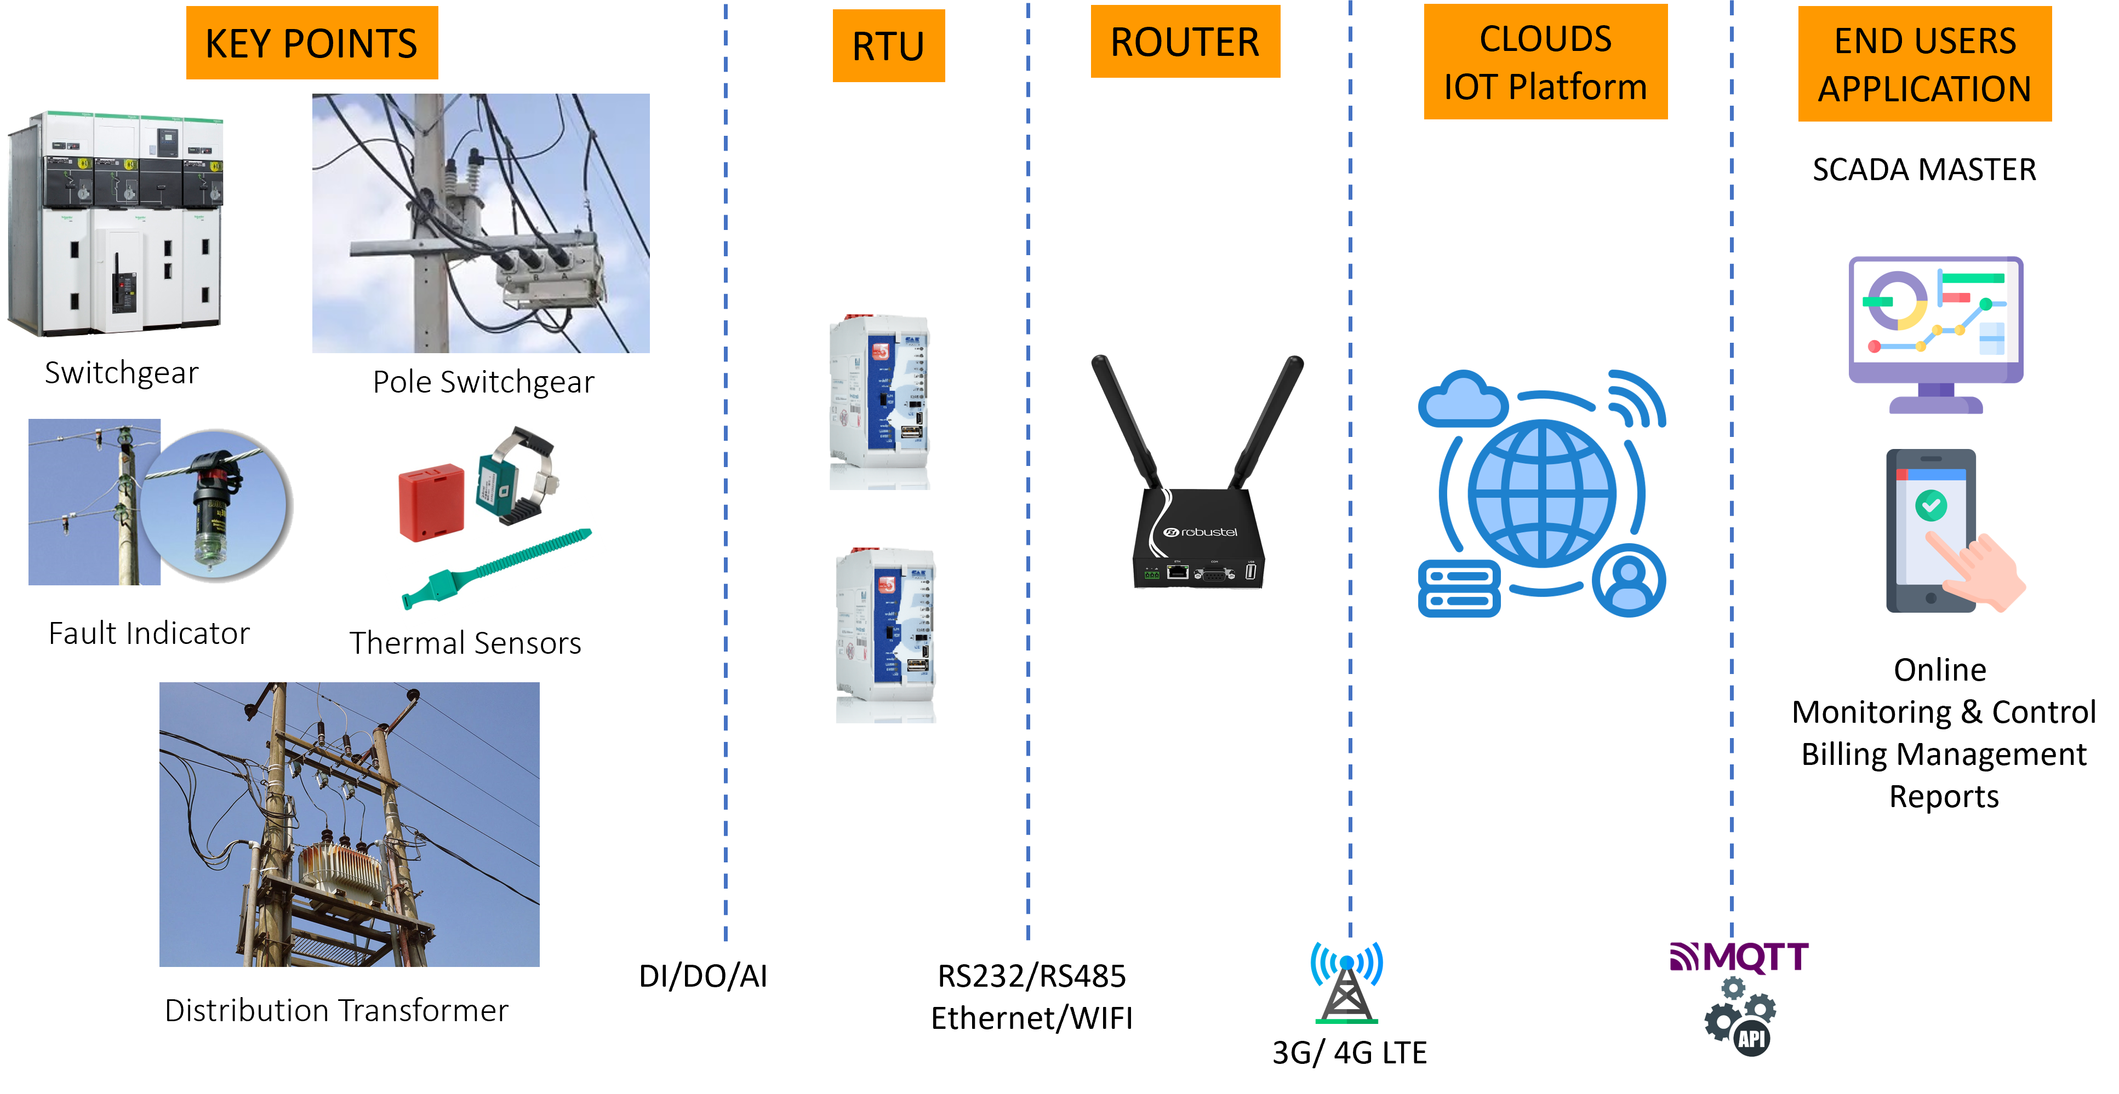
SCADA SYSTEM
HOME
ABOUT
SOLUTIONS
PRODUCTS
PROJECTS
CONTACT US
Image : 008_Scada Scheme.jpg
SOLUTIONS
ELECTRICAL SERVICE
Relay Protection
Generator ATS AMF
Energy Metering
Scada System
DC power Supply
Transformer Oil Purifier
ELECTRIC VEHICLE CHARGER (SPKLU)
ENERGY AND ENVIRONMENT MANAGEMENT
Energy Monitoring for Utilities
Street Lighting
CCTV
Water/ Flood Monitoring
To provide installation of Remote Terminal unit (RTU) and modem routers in keypoints : indoor and Pole mounting switchgears, MV/LV panels, Fault indicators, Thermal and Humidity Sensors (Early warning system) and Distribution Transformer Online Monitoring (Online losses Monitoring)
All data sent and monitored by Scada Master/ Energy Management System located in utility company (PLN) with means of communication : Cellular 4G router, fiber optic and Internet.
Integration any Modbus/IEC 104/DNP3/IEC61850 protocols IEDs to existing Scada master (Siemens/ Alstom/Survalen)
LINK >> More Project Reference
LINK >> More Product Detail

Slide 15
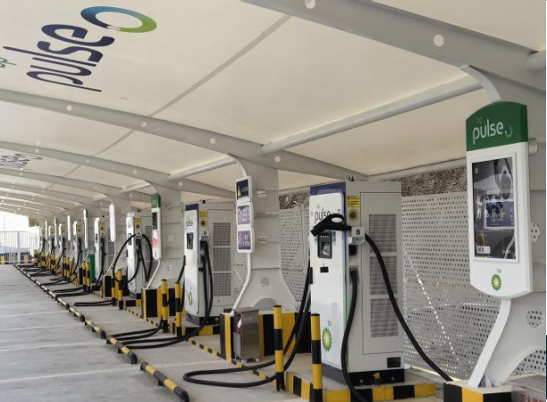
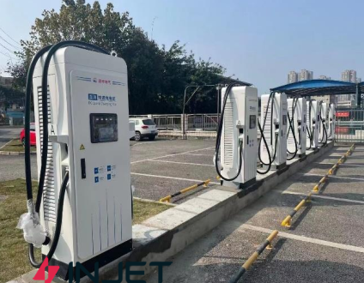
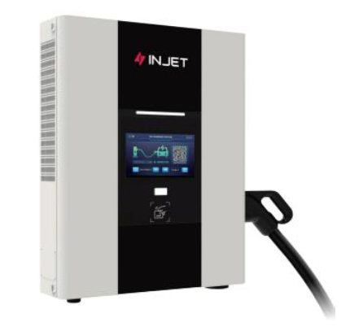
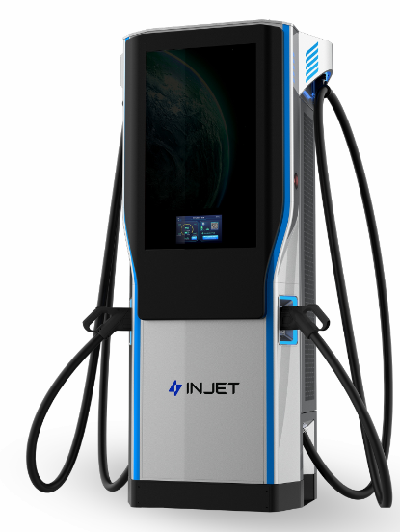
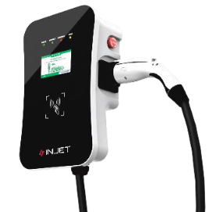
HOME
ABOUT
SOLUTIONS
PRODUCTS
PROJECTS
CONTACT US
ELECTRIC VEHICLE CHARGER (SPKLU)
Image :B_007_Ultra fast.jpg
SOLUTIONS
ELECTRICAL SERVICE
Relay Protection
Generator ATS AMF
Energy Metering
Scada System
DC power Supply
Transformer Oil Purifier
ELECTRIC VEHICLE CHARGER (SPKLU)
ENERGY AND ENVIRONMENT MANAGEMENT
Energy Monitoring for Utilities
Street Lighting
CCTV
Water/ Flood Monitoring
Image :B_006_integrated EVC.jpg
Integrated EV Charger
Ultra Fast EV Charger up to 320kW
Image :B_008_HUB.jpg
Image:B_003_Ampax.jpg
Ultra Fast Charger
AMPAX
60/120/160/180/
240/ 320 kw
Image :B_002_Swift.jpg
Home Wallbox Charger SWIFT 2.0
AC 7/11/22 kW
Small Commercial
HUB DC 20/30/40 kW

Slide 16
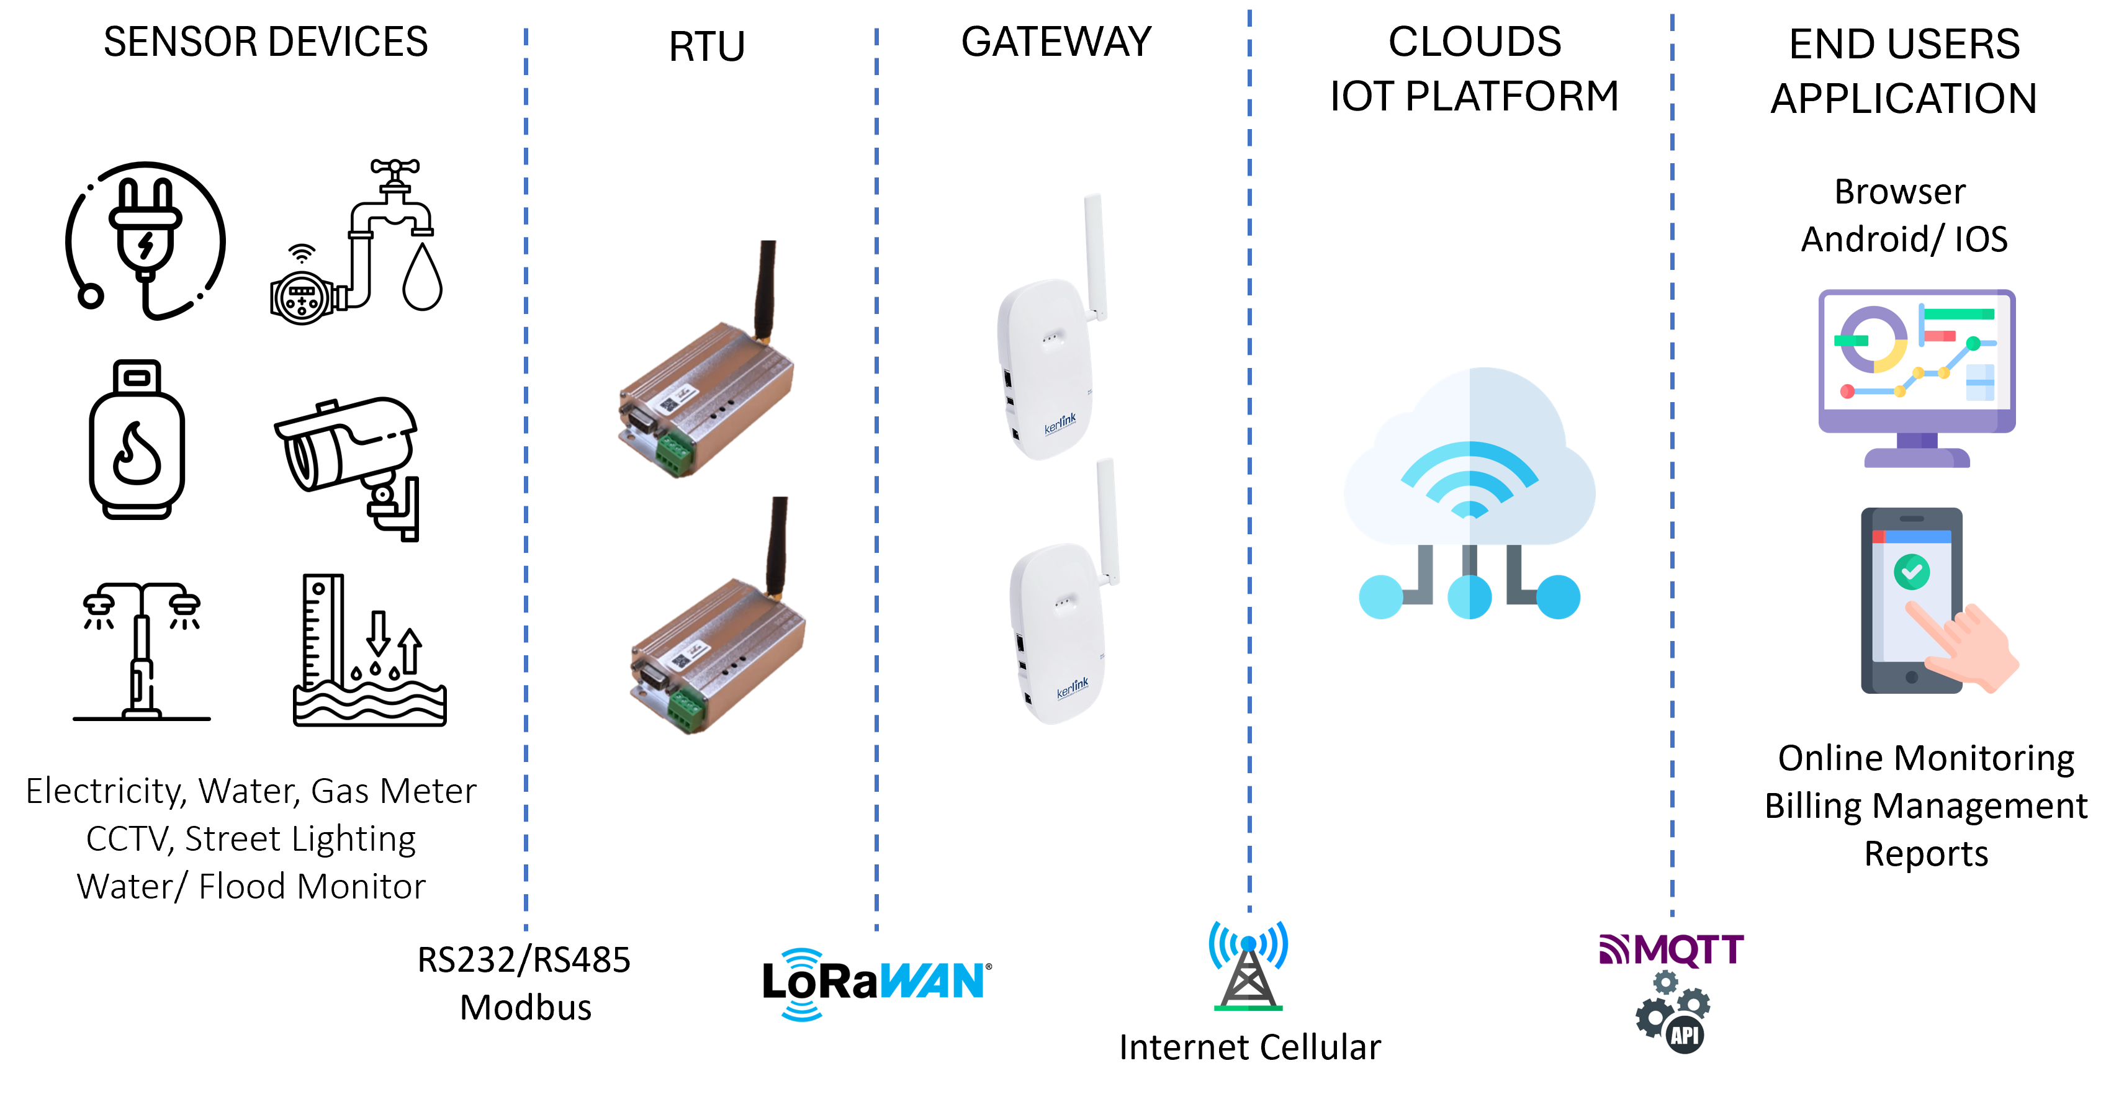
HOME
ABOUT
SOLUTIONS
PRODUCTS
PROJECTS
CONTACT US
ENERGY AND ENVIRONMENT MANAGEMENT
Image :009_Utility Scheme.jpg
SOLUTIONS
ELECTRICAL SERVICE
Relay Protection
Generator ATS AMF
Energy Metering
Scada System
DC power Supply
Transformer Oil Purifier
ELECTRIC VEHICLE CHARGER (SPKLU)
ENERGY AND ENVIRONMENT MANAGEMENT
Public Utilities Monitoring
Street Lighting
CCTV
Water/ Flood Monitoring
and flow.
PUBLIC UTILITIES MONITORING (Electricity, Gas, Water)
Electricity, gas and water meters with built-in LoRA modem or connect to LoRA RTU with Serial comm RS232/RS485. LoRAWAN Gateway can read the signal from LoRA RTU with 2 km with gaps from urban buildings and 5 km on open space. LoRAWAN Gateway connect to IOT Platform via internet or cellular networks. End users application both PC and mobile apps provide comprehensive data on online monitor and control and billing management
>> More Project Reference >> More Product Detail

Slide 17

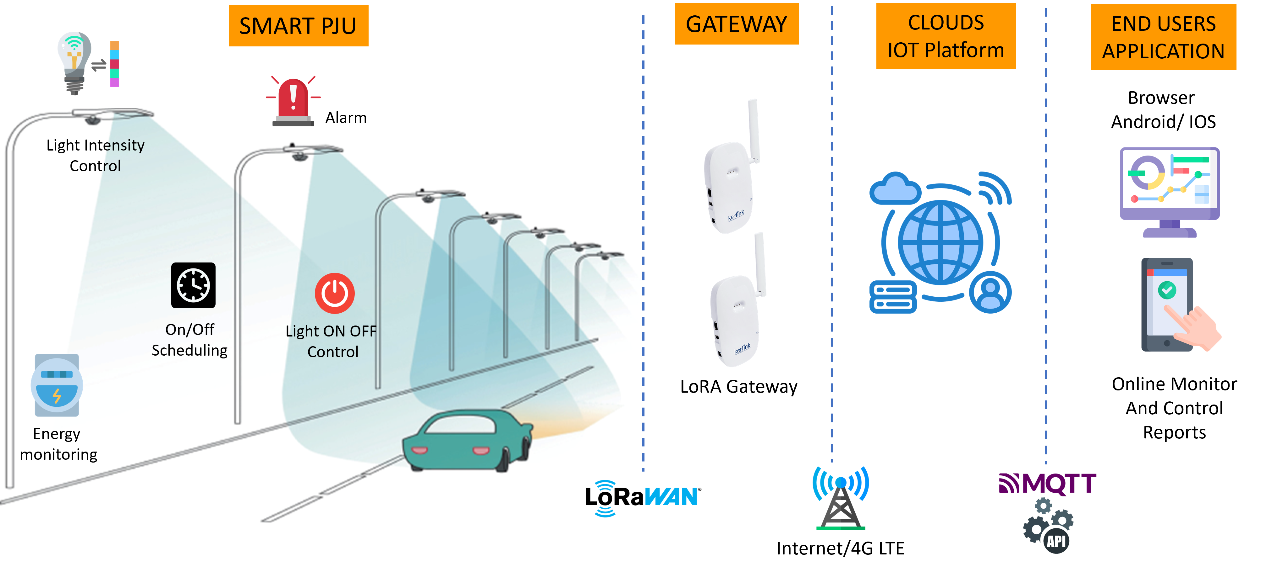
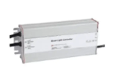
STREET LIGHTING
HOME
ABOUT
SOLUTIONS
PRODUCTS
PROJECTS
CONTACT US
SOLUTIONS
ELECTRICAL SERVICE
Relay Protection
Generator ATS AMF
Energy Metering
Scada System
DC power Supply
Transformer Oil Purifier
ELECTRIC VEHICLE CHARGER (SPKLU)
ENERGY AND ENVIRONMENT MANAGEMENT
Energy Monitoring for Utilities
Street Lighting
CCTV
Water/ Flood Monitoring
Image 010_Streetlamp Scheme.png
Smart Lamp
Nema controller
Complete solution for energy billing, scheduling timer and ON/OFF, light intensity and Alarm of Street Lighting Exposed sectors : Residential/Commercial/Industrial estates, Local Government (PEMDA)
Monitoring
To know the current condition of the lamps by sending data parameters via application online 24/7
Controlling
Done by remote to reach efficiency and speed of service
Internal Single light
controller
Good for Money
By performing efficient and man-free operation to save more money in Energy consumption and man power
>> More Project Reference >> More Product Detail

Slide 18
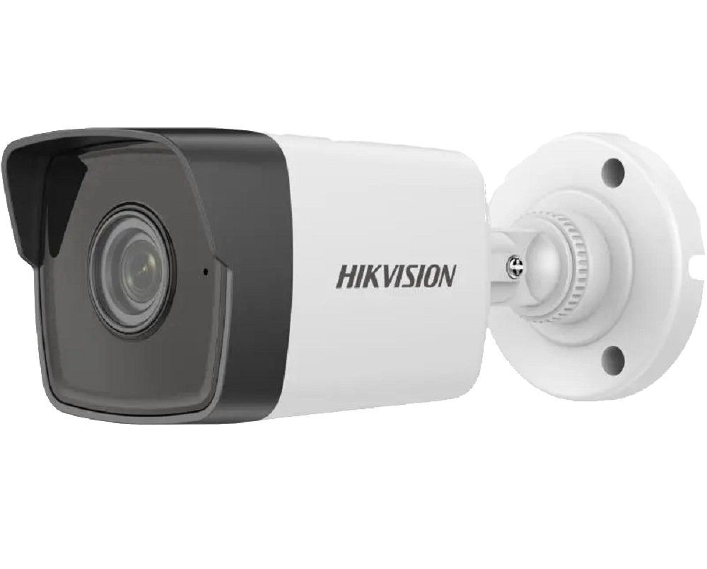
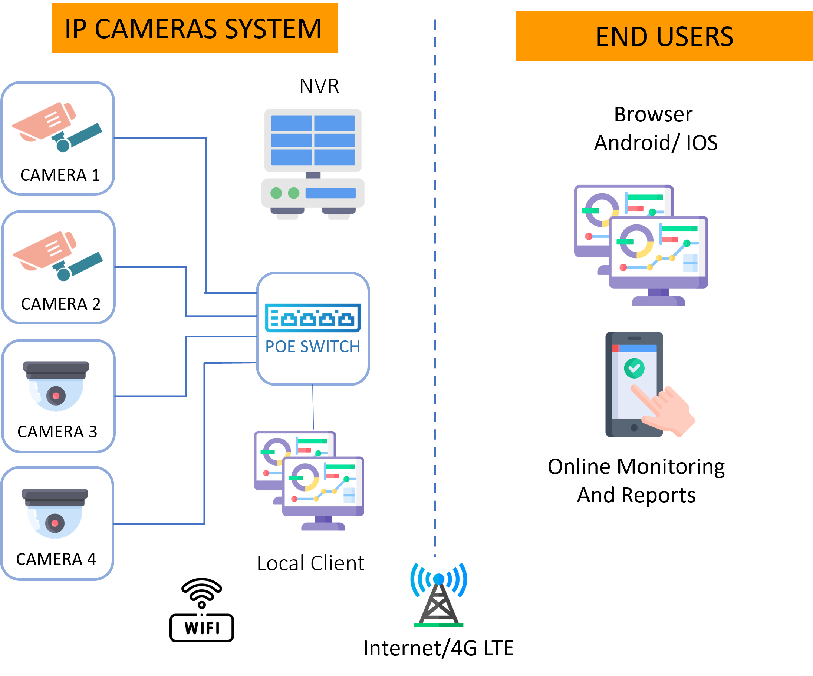

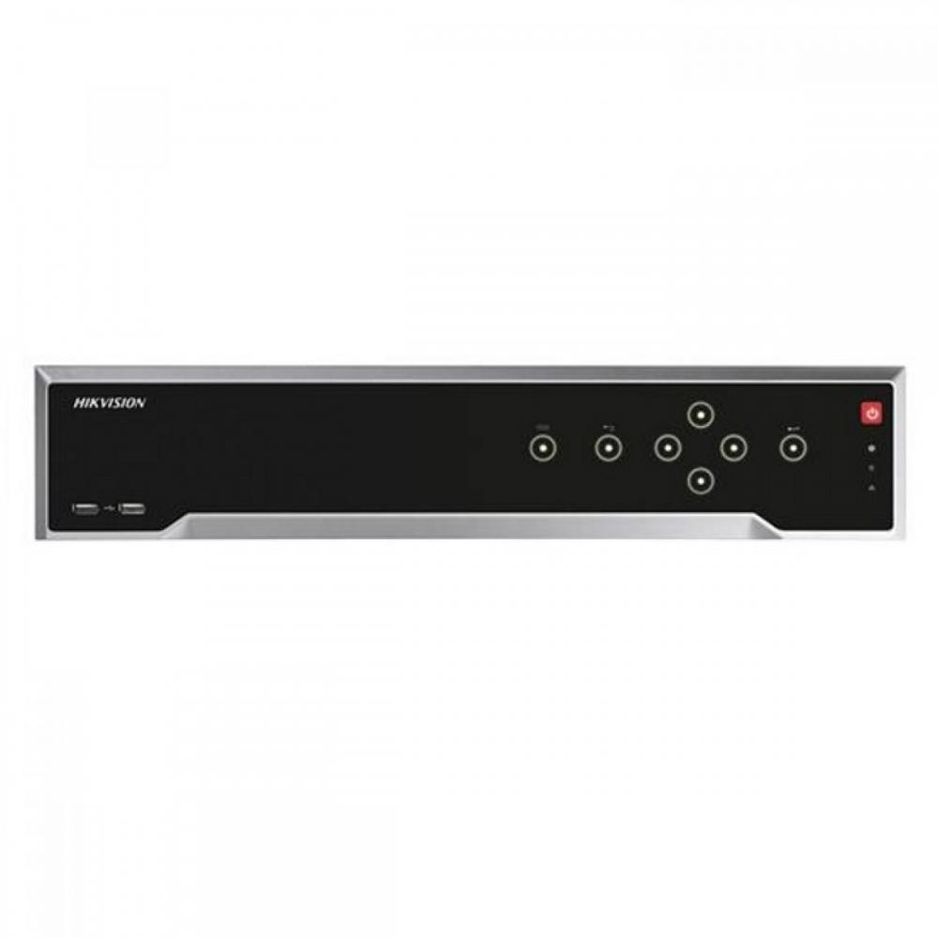
CCTV
HOME
ABOUT
SOLUTIONS
PRODUCTS
PROJECTS
CONTACT US
Image : 011_CCTV Scheme.png
SOLUTIONS
ELECTRICAL SERVICE
Relay Protection
Generator ATS AMF
Energy Metering
Scada System
DC power Supply
Transformer Oil Purifier
ELECTRIC VEHICLE CHARGER (SPKLU)
ENERGY AND ENVIRONMENT MANAGEMENT
Energy Monitoring for Utilities
Street Lighting
CCTV
Water/ Flood Monitoring
Outdoor IP camera
Indoor IP camera
Network Video Recorder
WIFI/ Ethernet IP cameras are monitored by Network Video Recorder (NVR)
Local client can access cameras and sensors via LAN/ WIFI while Remote clients access via internet connection
All footages recorded digitally
>> More Project Reference >> More Product Detail

Slide 19
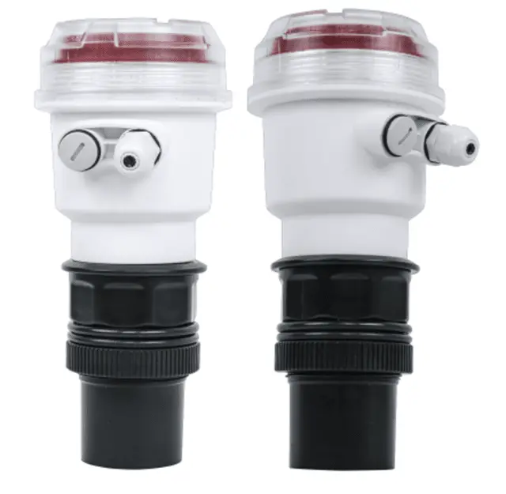
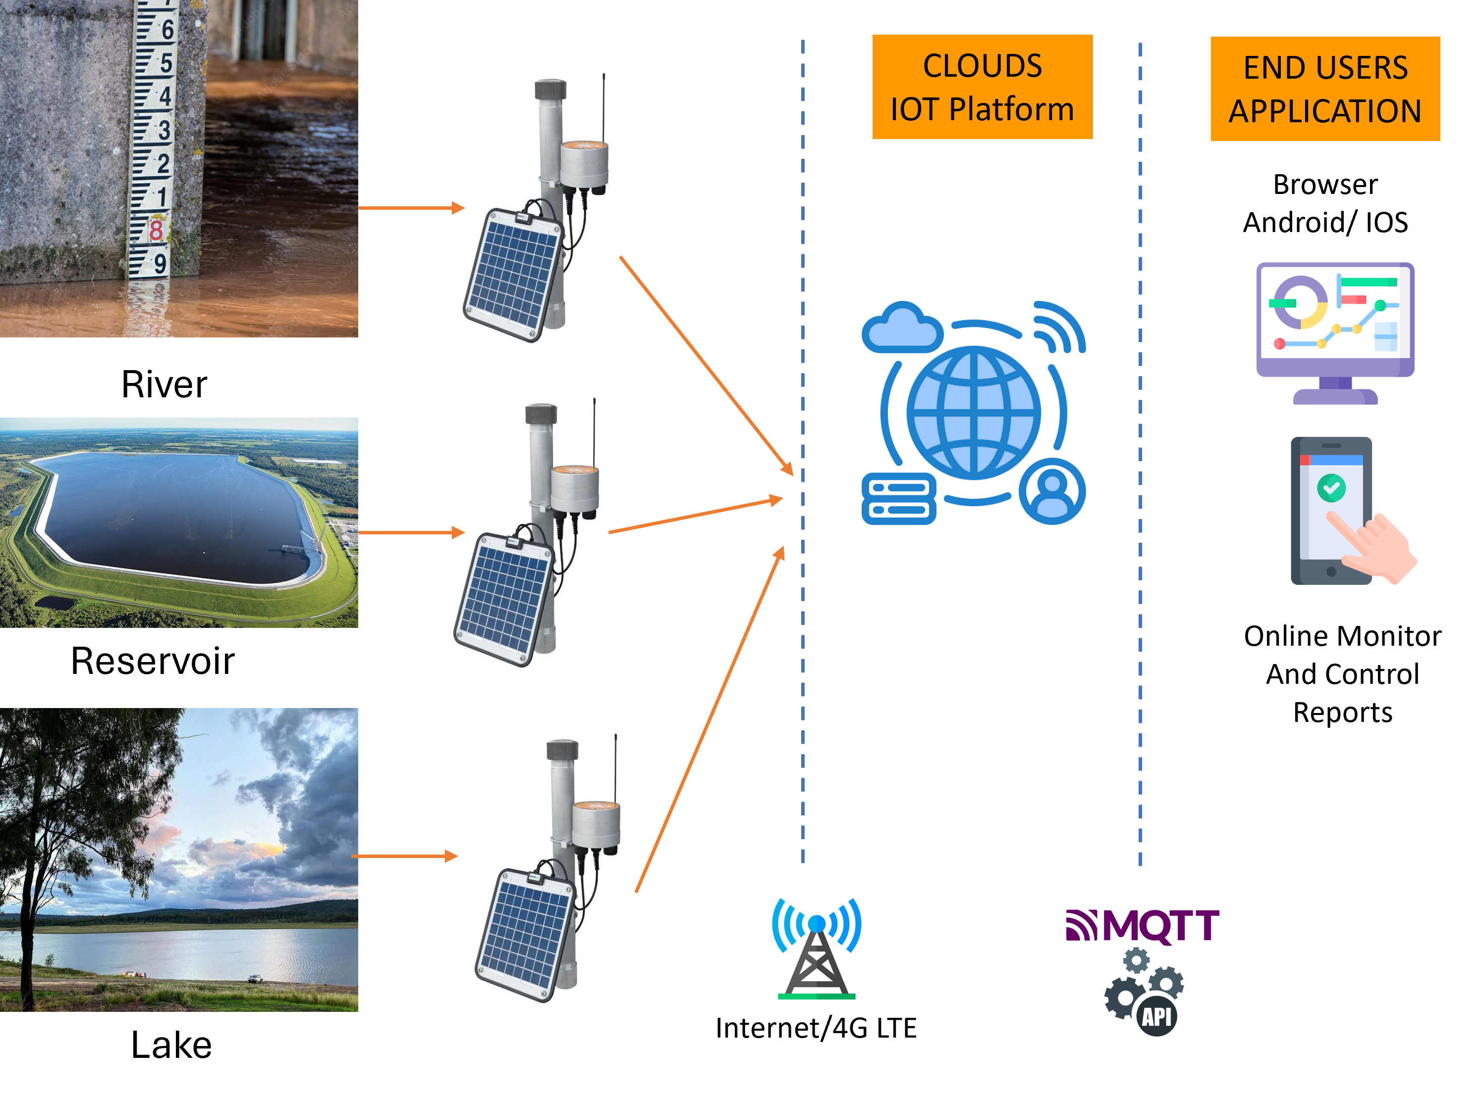
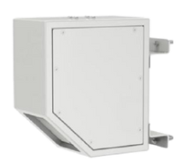
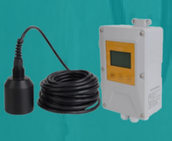
WATER/ FLOOD MONITORING
HOME
ABOUT
SOLUTIONS
PRODUCTS
PROJECTS
CONTACT US
Water Level Sensor The ultrasonic level sensor is a low-cost, non-contact and easy-to-install measurement device. It is able to meet the every-day needs of commercial production,
Image 012_Flood Monitor.png
SOLUTIONS
ELECTRICAL SERVICE
Relay Protection
Generator ATS AMF
Energy Metering
Scada System
DC power Supply
Transformer Oil Purifier
ELECTRIC VEHICLE CHARGER (SPKLU)
ENERGY AND ENVIRONMENT MANAGEMENT
Energy Monitoring for Utilities
Street Lighting
CCTV
Water/ Flood Monitoring
RADAR FLOW METER
A radar sensor that can assist in reading liquid/solids levels up to a
height of 20 meters. This sensor is designed using DSP technology
and advances phyTrack fluid velocity detection and tracking
algorithms specifically for open channel surface velocity and flow.
ULTRASONIC SILT LEVEL SENSOR
Ultrasonic sludge interface meter, also known as ultrasonic silt level meter, is a contact-type, high reliability, easy-to-install
And maintain solid-liquid
interface monitoring instrument.
Monitoring water level with IoT sensor to monitor the river water level due to flood
Submersible sensors and Ultrasonic sensors for Water level and flow
>> More Project Reference >> More Product Detail

Slide 20
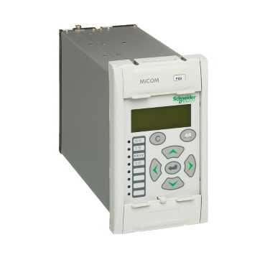

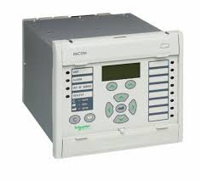
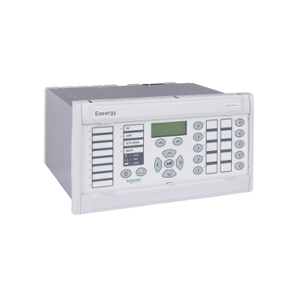
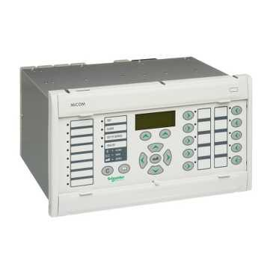
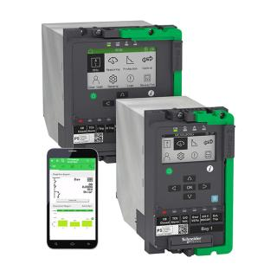
HOME
ABOUT
SOLUTIONS
PRODUCTS
PROJECTS
CONTACT US
Electrical Electric Vehicle Charger (SPKLU)
Energy & Environment Management
Water Tank Test & Measurement Tools
OUR PRODUCTS
ELECTRICAL
Relay Protection
Generator ATS AMF
Energy Metering
Scada System
DC power Supply
Transformer Oil Purifier
Distribution Transformer monitoring
Temperature Monitoring/ EWS
ELECTRIC VEHICLE CHARGER (SPKLU)
AC and Small DC Charger
Ultra Fast DC Charger
ENERGY AND ENVIRONMENT MANAGEMENT
Energy Meters
Gas Meters
Water Meters
Cybel Nomag Sensor
Lora RTU
CCTV & Electronic Security
WATER TANK
TEST & MEASUREMENT TOOLS
PROTECTION RELAYS
MICOM P123, 127
FEEDER MANAGEMENT RELAY
3Ph Over current (50/51P), Ground fault (50/51N)
Phase & Ground Fault directional 67(P), 67N
Restricted earth fault (64)
Negative sequence overcurrent (46)
Undercurrent (37), Broken conductor (46BC)
Circuit breaker failure (50BF), Trip Circuit Spv (TCS)
Over/Under voltage (27/59)
Residual over voltage (59N), Autoreclose (79)
Modbus protocol/ DNP3
MiCOM P543
LINE CURRENT DIFFERENTIAL RELAY
3ph Overcurrent/ Groundfault 50N/51N, Directional earth fault
Undervoltage ANSI Code: 27, Overvoltage ANSI Code: 59
Negative/unbalanced sequence ANSI code: 46
Directional phase overcurrent, Thermal overload protection ANSI code: 49RMS
Watt metric grounding, Synchronization - check ANSI code: 25
Underfrequency ANSI Code: 81L
Over frequency Number of inputs16 discrete
5 CT current inputs...X/5 A and X/1 A, 4 voltages Number of outputs14 discrete
Communication port protocols DNP3, IEC 61850,
Ethernet, Modbus RTU, Event recording
MICOM P142 ,P143
FEEDER MANAGEMENT RELAY IEC61830 SAS
3Ph Over current (50/51P), Ground fault (50/51N)
Phase & Ground Fault directional 67(P), 67N
Restricted earth fault (64)
Negative sequence over current (46)
Undercurrent (37), Broken conductor (46BC)
Circuit breaker failure (50BF), (TCS)
Over/Under voltage (27/59),Residual overvoltage (59N), Auto reclose (79),
IEC 61860 protocol SAS/ DNP3
EASERGY P3, P5
Built-in arc flash protection
Advanced cybersecurity compliant to IEC 62443
Intuitive withdrawable design with backup memory
Plug and play hardware expansion
EF, Dir OCR, Dir EF, UFR, OVR, 32 Reverse Power 10DI
+ 8DO + Back Up Memory Protocol IEC 61850 for SAS and DNP 3 serial for
DCC Simultaneous

Slide 21
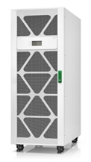
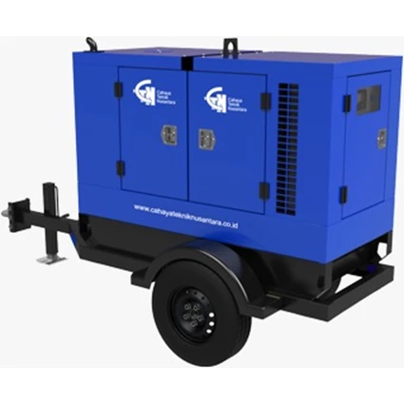
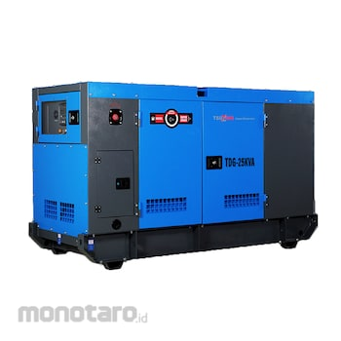
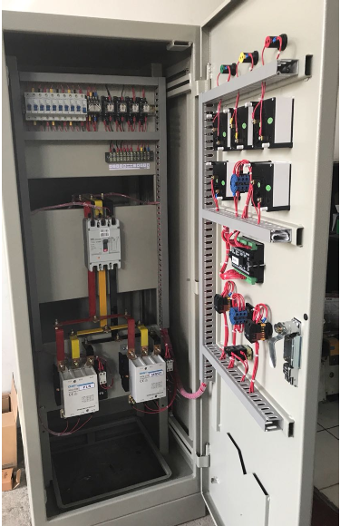
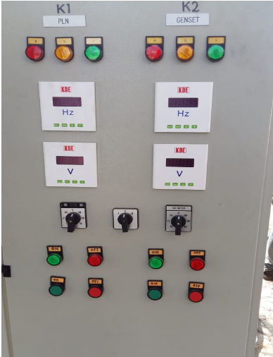
HOME
ABOUT
SOLUTIONS
PRODUCTS
PROJECTS
CONTACT US
OUR PRODUCTS
ELECTRICAL
Relay Protection
Generator ATS AMF
Energy Metering
Scada System
DC power Supply
Transformer Oil Purifier
Distribution Transformer monitoring
Temperature Monitoring/ EWS
ELECTRIC VEHICLE CHARGER (SPKLU)
AC and Small DC Charger
Ultra Fast DC Charger
ENERGY AND ENVIRONMENT MANAGEMENT
Energy Meters
Gas Meters
Water Meters
Cybel Nomag Sensor
Lora RTU
CCTV & Electronic Security
WATER TANK
TEST & MEASUREMENT TOOLS
GENSET AMF BACK UP POWER SUPPLY
UPS
The UPS provides continuous power from the internal battery until utility power returns to safe levels or the battery is fully discharged.
Intuitive LCD interface
Capacity 1-30kVA
Predictive replace battery date
Energy meter - Provides actual kilowatt hours of usage for energy conscious users.
Pure sine wave output on battery - Battery failure notification - Provides early-warning fault analysis on batteries enabling timely preventive maintenance
Serial Connectivity - for Scada application
GENERATOR SET
Silent Type, Trailer (option)
Engine : Cummins/Perkins
Alternator : Stamford
Power Output : 50 - 1500 kVA
Phase 3 ( Three) 3 ( Three)
Frequency 50 Hz @1500RPM 50 Hz @1500RPM
Voltage 220 / 380 V 220 / 380 V
High quality, reliable and complete generating sets.
Easy for operation and maintenance.
Compact structure &high-strength chassis.
Base frame design incorporates an intergrade fuel tank for at least 8 hours running (up to 650KVA).
Anti- vibration pads are mounted between the engine/alternator feet and the base frame.
ATS AMF
The electronic control unit (AMF) automatically detects the conditions of absence and return of the mains, managing both the startup and shutdown of the generator, and the switching of the contactor (ATS).
Powder coating Box Panel Wall mounting ( Custom dimension)
COS 4P 160A Transfer switch Motorized
Digital metering Volt Ampere Frequency LED display
Mode Auto - Manual or selector A-O-M
Load indication PLN-Load-Genset dengan pilot lamp
Overcurrent protection MCCB 3P 125A
Setting Close delay dan return delay
Automatic Battery charger 12/24V 5A
Under/over voltage Protection phase failure relay
Modul Automatic Main Failure (AMF)
Deepsea ATS controller

Slide 22
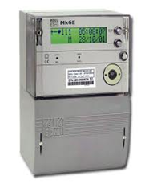

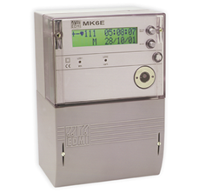
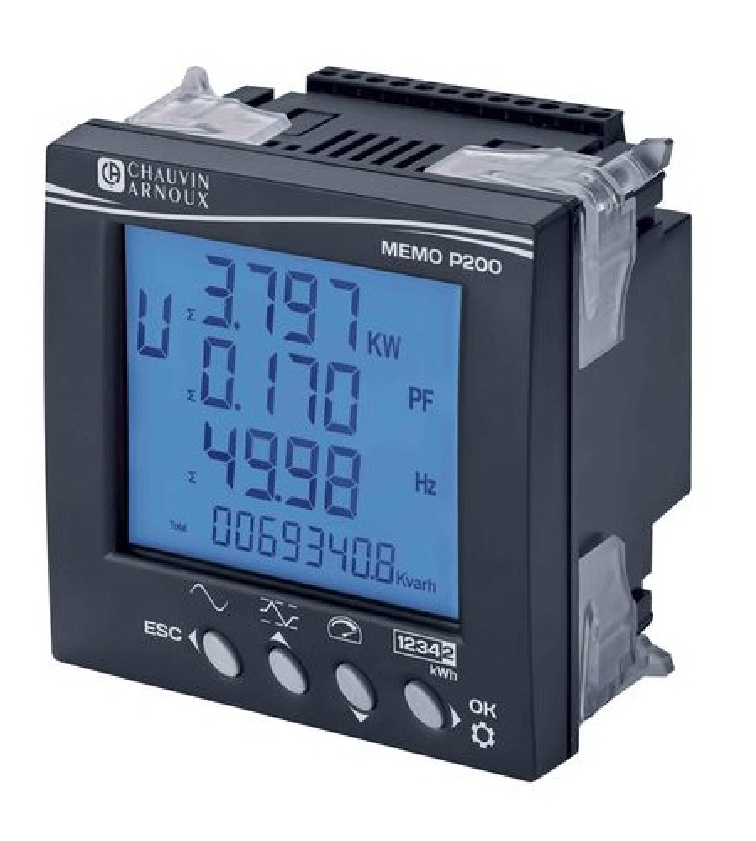
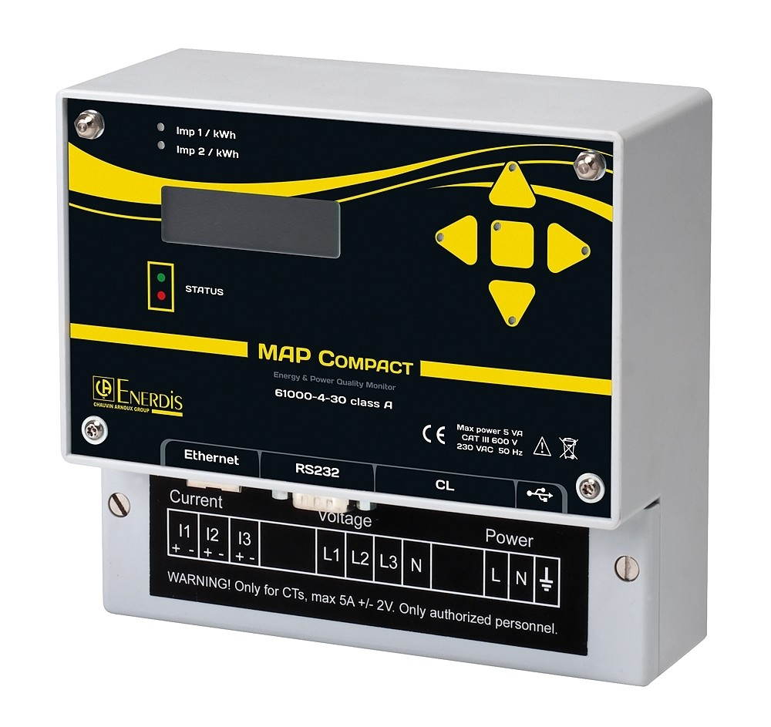
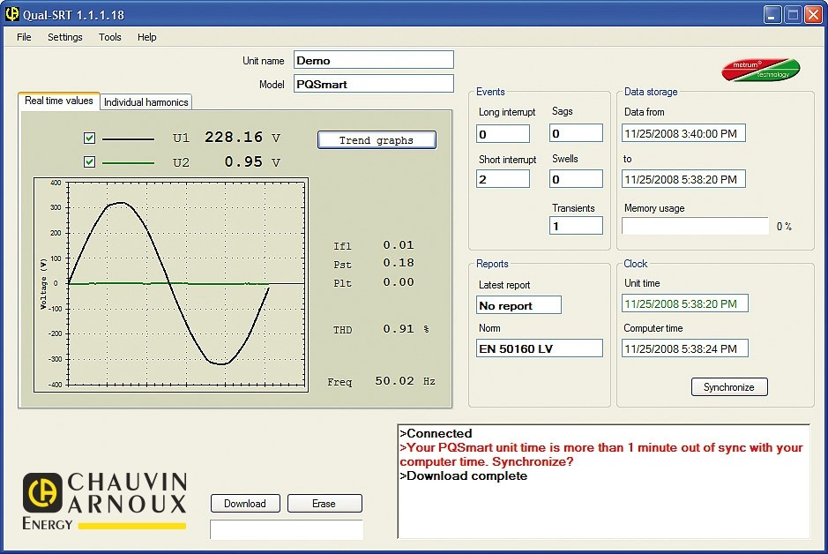
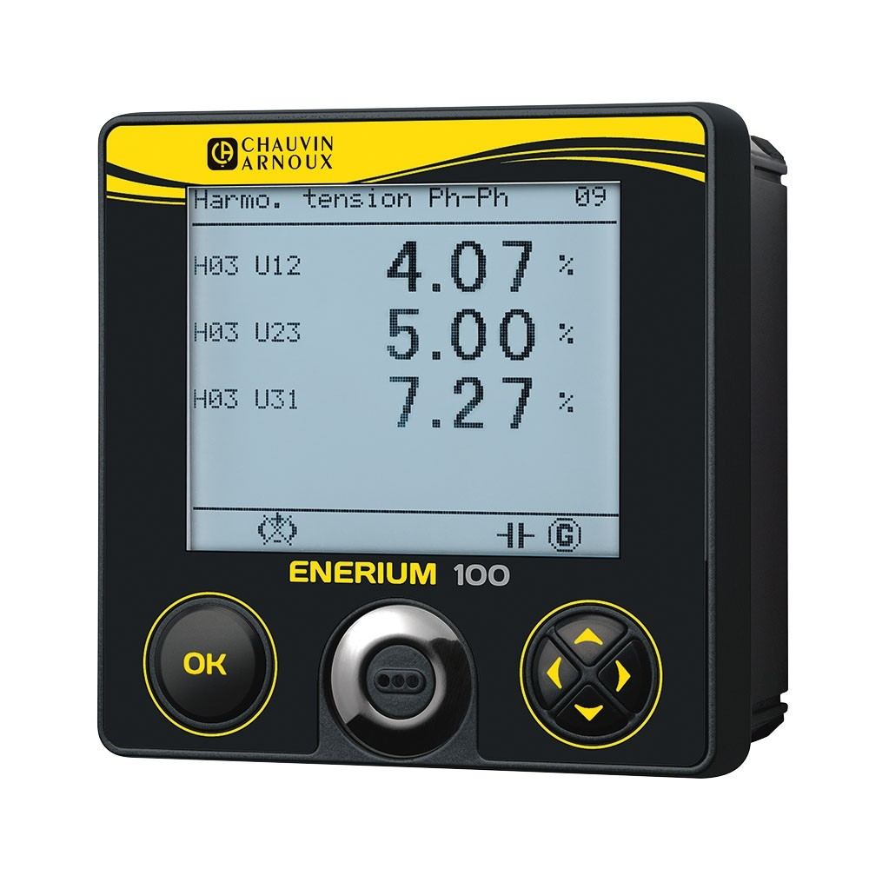
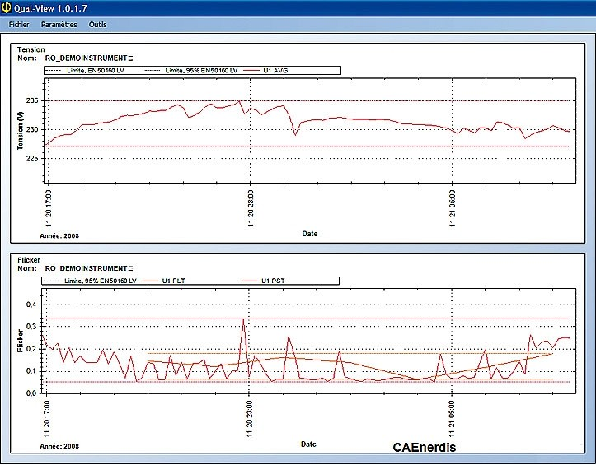
HOME
ABOUT
SOLUTIONS
PRODUCTS
PROJECTS
CONTACT US
OUR PRODUCTS
ELECTRICAL
Relay Protection
Generator ATS AMF
Energy Metering
Scada System
DC power Supply
Transformer Oil Purifier
Distribution Transformer monitoring
Temperature Monitoring/ EWS
ELECTRIC VEHICLE CHARGER (SPKLU)
AC and Small DC Charger
Ultra Fast DC Charger
ENERGY AND ENVIRONMENT MANAGEMENT
Energy Meters
Gas Meters
Water Meters
Cybel Nomag Sensor
Lora RTU
CCTV & Electronic Security
WATER TANK
TEST & MEASUREMENT TOOLS
ENERGY METERING
MK-6N Class 0.5S
Class 0.5s (IEC 62053-22, IEC 62052-11
Nominal Voltage (P-N) : 57-240 V
Current : CT 5(10)A CT
Serial Port RS232 & RS 485
Measurement Modes : 3P2W & 3P3W
Aux Voltage : 100V-240 V AC/DC
Serial ports : RS232 and RS485
Modbus protocol
MK6E CLASS 0.2S
Class 0.2S (IEC 62053-22, IEC 62052-11)
Nominal Voltage (P-N) 57 to 240 V
Current : CT 1/4 A, 5/20A
Auxiliary Supply : 240V, 110V
Measurement Modes : 3P2W & 3P3W
Communication : RS232/RS485
Modbus protocol
MAP COMPACT POWER QUALITY ANALYZER
Built-in display
To Monitor and record Lfl, Pst and Plt flicker, dips
/over voltages / outages
Measurement compliant with IEC 61000-4-30 Class A
Integrated EN50160 report generation
Harmonics up to the 50th order
Waveform capture with programmable pre-time and post-time
Measurement of power and energy values as primary quantities
software; Qual-SRTc, Qual-View
Voltage input: 3 channels: 0-364/0-630 VRMS
Current input: 4 channels, 0-6 A RMS (clip on CT option)
Auxiliary power supply: 175-255 Vac (10s power reserve)
Communication: RS232 / Current loop / Ethernet port / Mini USB
POWER QUALITY METER
MEMO / ENERIUM
Accuracy suitable for the most critical MV/LV
Measurements with The operating history and diagnostic tools
Accuracy class (as per IEC 61557-12) 0.5 or 0.2
Number of alarms 16
Time/date-stamped events recorded 64
Power quality
THD / PF / Tan φ
Max. harmonic orders 25/50
Qualimetry as per EN50160
Capture of V, U, I & In waveforms 16
Storage of the last 1,024 time/date-stamped
events (dips, outages, overvoltage)
Inputs / Outputs Max. 8

Slide 23

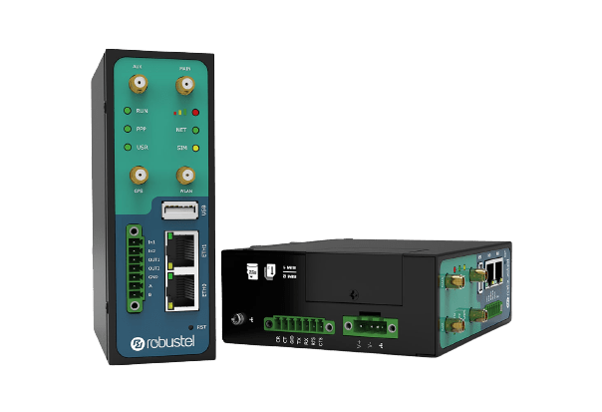
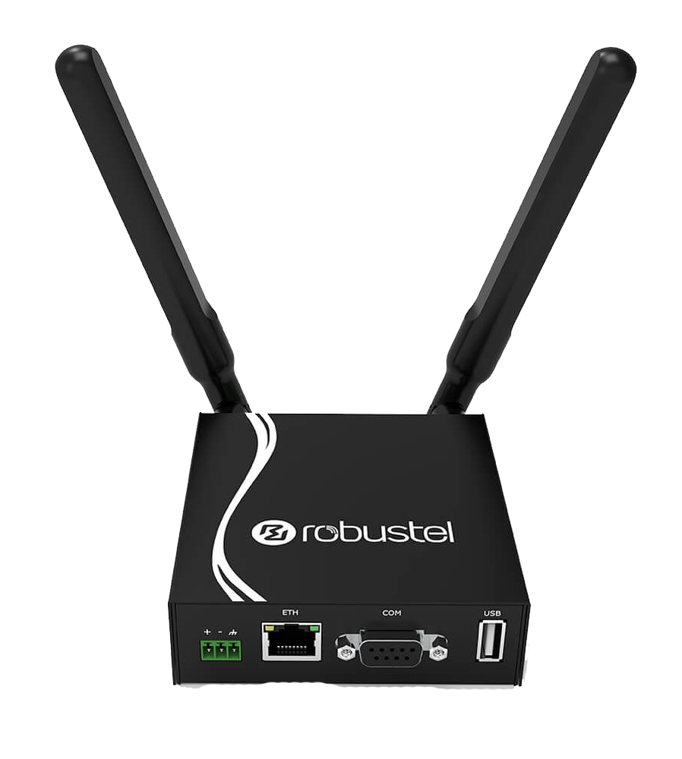
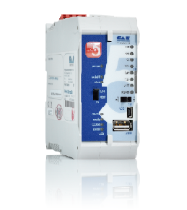


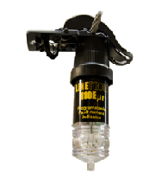
HOME
ABOUT
SOLUTIONS
PRODUCTS
PROJECTS
CONTACT US
SCADA SYSTEMS
OUR PRODUCTS
ELECTRICAL
Relay Protection
Generator ATS AMF
Energy Metering
Scada System
DC power Supply
Transformer Oil Purifier
Distribution Transformer monitoring
Temperature Monitoring/ EWS
ELECTRIC VEHICLE CHARGER (SPKLU)
AC and Small DC Charger
Ultra Fast DC Charger
ENERGY AND ENVIRONMENT MANAGEMENT
Energy Meters
Gas Meters
Water Meters
Cybel Nomag Sensor
Lora RTU
CCTV & Electronic Security
WATER TANK
TEST & MEASUREMENT TOOLS
CELLULAR ROUTER
ROBUSTEL R3000
Industrial Dual SIM Cellular VPN Router
2 Eth + 1 USB Host + 2 x RS232 or 1 x RS232
+ 1 x RS485
Cellular router offering state-of-the-art mobile connectivity for machine to machine (M2M) applications.
Cellular Interface
Number of antennas 2 (MAIN + AUX)
Connector SMA-K
SIM 2 x Mini SIM (2FF)
Ethernet Interface
Number of ports 2 x 10/100 Mbps, 2 x LAN or 1 x LAN + 1 x WAN
Magnet isolation protection 1.5 KV
Wi-Fi Interface (Optional)
Number of antennas 1
Connector RP-SMA-K
Standards 802.11 a/b/g/n, supports AP and Client modes
Data speed Up to 150 Mbps
Serial Interface
Number of ports 2 x RS232 or 1 x RS232 + 1 x RS485
Baud rate 300 bps ~ 230400 bps
DI/DO
Type 2 x DI (dry contact) + 2 x DO (wet contact),
Connector 7-pin 3.5 mm female socket with lock
RTU
FW-5-GATE
2 Ethernet LAN TCP/IP connections
2 RS-485 , RS-232/V.24 interface
Temp sensor, -20° to 100° C
Power supply (20 to 72 V DC)
Protocols IEC 61850 IED,
IEC 60870-5-101 IEC 60870-5-103
IEC 60870-5-104, TCP/IP DNP3
IEC 62056-21, Modbus RTU/TCP
FAULT INDICATOR
LineTroll 110EμR
Distribution Networks (6-50kV)
LineTroll 110EμR conductor mounted
indicator for detection of PtG and
PtP faults in overhead line networks.
A built-in 2.4GHZ radio device communicate with receiver/ RTU/ Scada Master

Slide 24
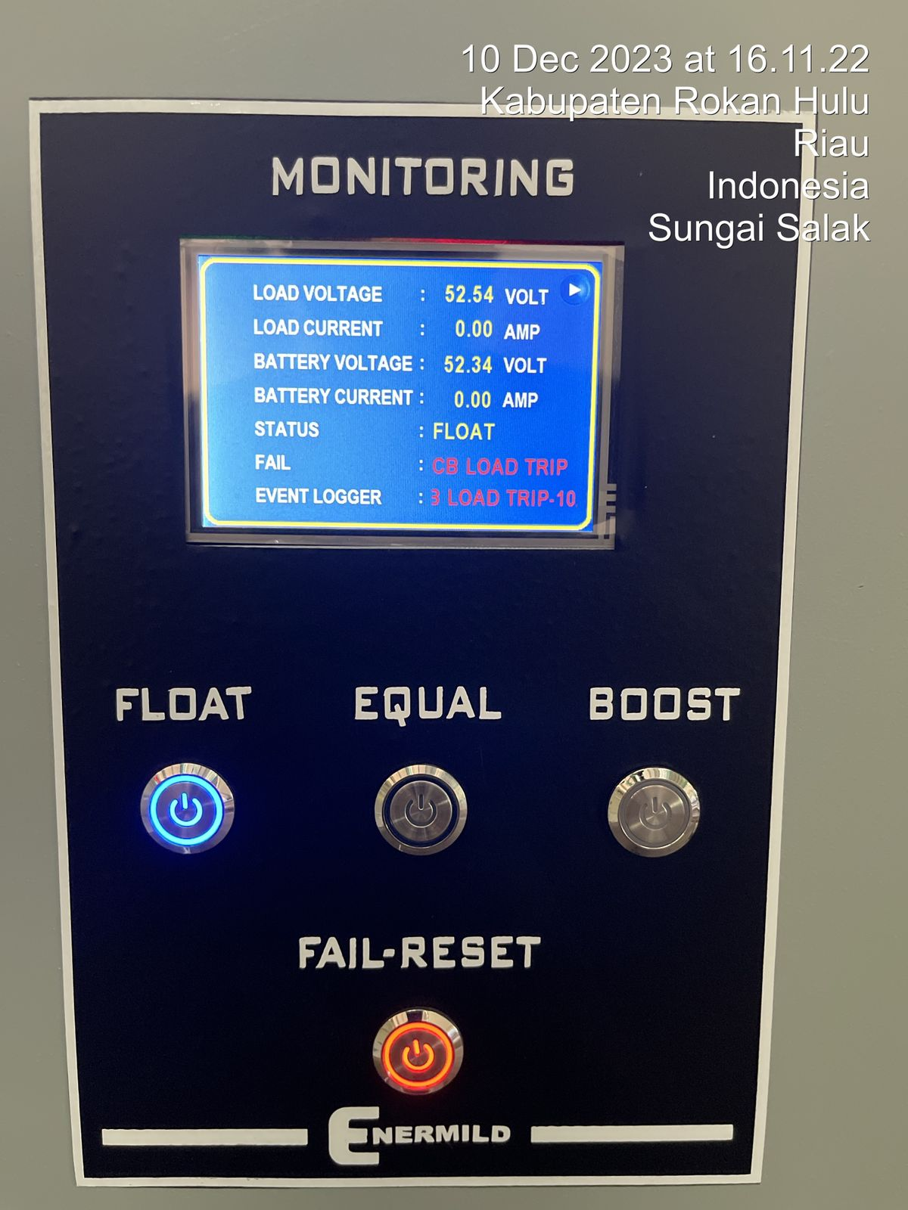
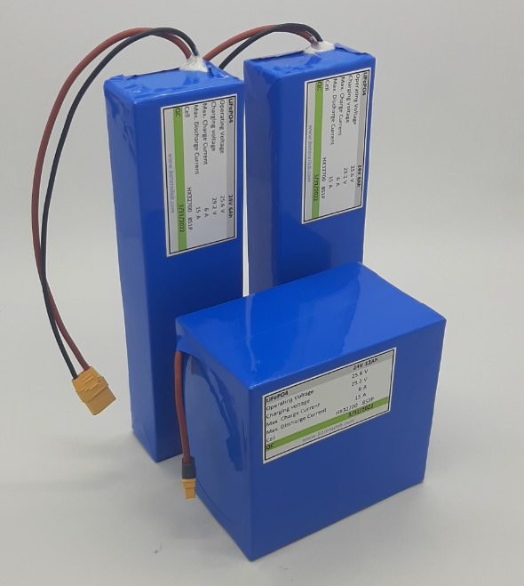
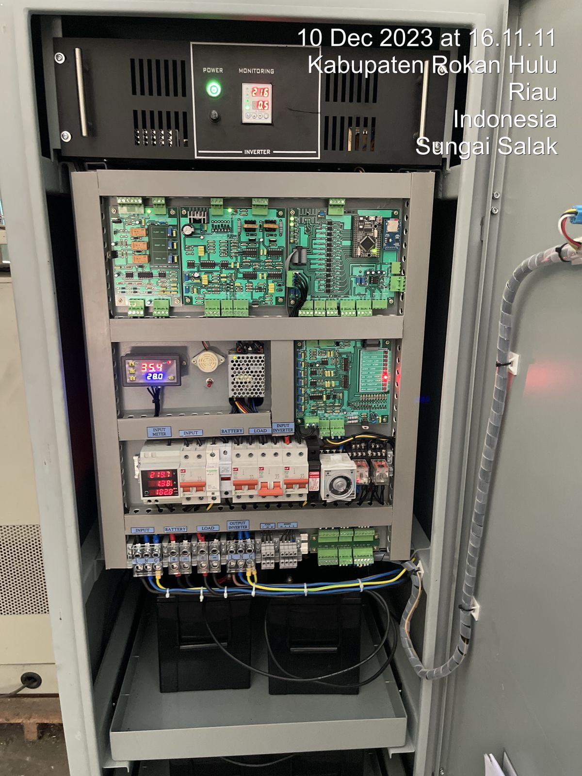
HOME
ABOUT
SOLUTIONS
PRODUCTS
PROJECTS
CONTACT US
OUR PRODUCTS
ELECTRICAL
Relay Protection
Generator ATS AMF
Energy Metering
Scada System
DC power Supply
Transformer Oil Purifier
Distribution Transformer monitoring
Temperature Monitoring/ EWS
ELECTRIC VEHICLE CHARGER (SPKLU)
AC and Small DC Charger
Ultra Fast DC Charger
ENERGY AND ENVIRONMENT MANAGEMENT
Energy Meters
Gas Meters
Water Meters
Cybel Nomag Sensor
Lora RTU
CCTV & Electronic Security
WATER TANK
TEST & MEASUREMENT TOOLS
DC POWER SUPPLY
RECTIFIERS, INVERTER
BATTERY CHARGER
LIFEPO4 BATTERY
Automatic voltage control & current limiting Thyristor (SCR) controlled and Suitable for all industrial Lead acid and Ni-Cd/ Lithium batteries
Rectifier 220 VAC to 48 VDC
Capacity | 10 – 200 A
Space Battery | up to 4 batteries
Nominal lnput voltage | 220 VAC single phase
Nominal Output voltage | 48 VDC
Output | Load dan battery charge
Type Charging | Boosting, Floating dan Equalizing
Ambient Temperatur | 0-40 C
Surge Protector | up to 4 kVA
Overvoltage Protector | up to 500 VAC
Display (Analog atau digital) | Load current, Battery charge Current, Voltage
Alarm/indicator | overload, voltage input dan output fail
Communication | RS232, RS485/ Modbus, TCP/IP
Customized dimension
based on Panel dimension
Voltage 12/48/110VDC
Capacity 5-30 VA
BMS 60A, maximum charging 30A
Maximum Load 60A
Enclosure Fiberglass sheet + PVC
XT60 connectors
Application
DC power supply, Engine starting battery, electric bicycle/motorcycle/scooter,
power tools and Solar Lighting
Inverter 48 VDC to 220 VAC
Capacity | Up to 10A
Nominal Input Voltage | 220 VAC single phase
Nominal Output voltage | 220VAC
Surge Protector | up to 4 kVA
Overvoltage Protector | up to 500 VAC

Slide 25
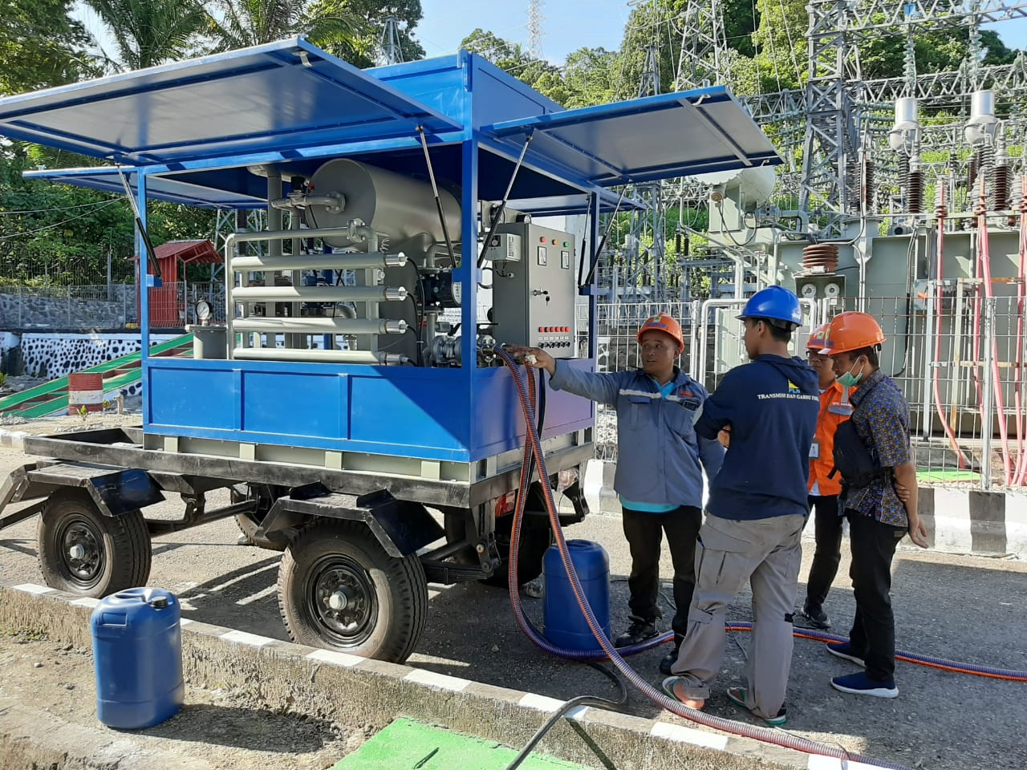

HOME
ABOUT
SOLUTIONS
PRODUCTS
PROJECTS
CONTACT US
OUR PRODUCTS
ELECTRICAL
Relay Protection
Generator ATS AMF
Energy Metering
Scada System
DC power Supply
Transformer Oil Purifier
Distribution Transformer monitoring
Temperature Monitoring/ EWS
ELECTRIC VEHICLE CHARGER (SPKLU)
AC and Small DC Charger
Ultra Fast DC Charger
ENERGY AND ENVIRONMENT MANAGEMENT
Energy Meters
Gas Meters
Water Meters
Cybel Nomag Sensor
Lora RTU
CCTV & Electronic Security
WATER TANK
TEST & MEASUREMENT TOOLS
TRANSFORMER OIL PURIFIER
PORTABLE OIL TEST SET
OTS80PB
Test voltages 60 kV / 80 kV
Lock in precision oil vessel
lockable gap setting
Flat electrode gap gauges
Oil Temperature Measurement
Easy to clean
Purifier is mainly used to improve insulation oil by removing trace water, gas, particulate matters etc. to boost performance and life time of transformers, circuit breakers, mutual inductors and cable.
Capacity : 2000, 4000, 6000 liter/hour,
Process : Double stage : heating to remove water from oil, gas (de-gas) and remove tiny particles (purify) eq. acetylene, hydrogen, methane dan other particles. Trailer provided mobility.
Key projects :
PLN UPK Kapuas, UP3 Ketapang and UP3B Kalbar , UPK Tambora NTB,

Slide 26

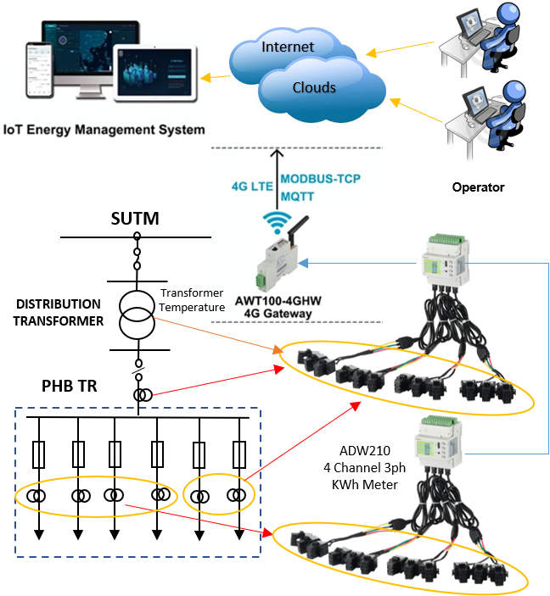
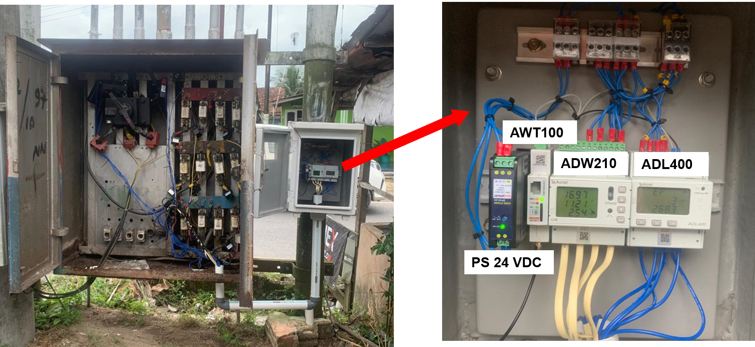
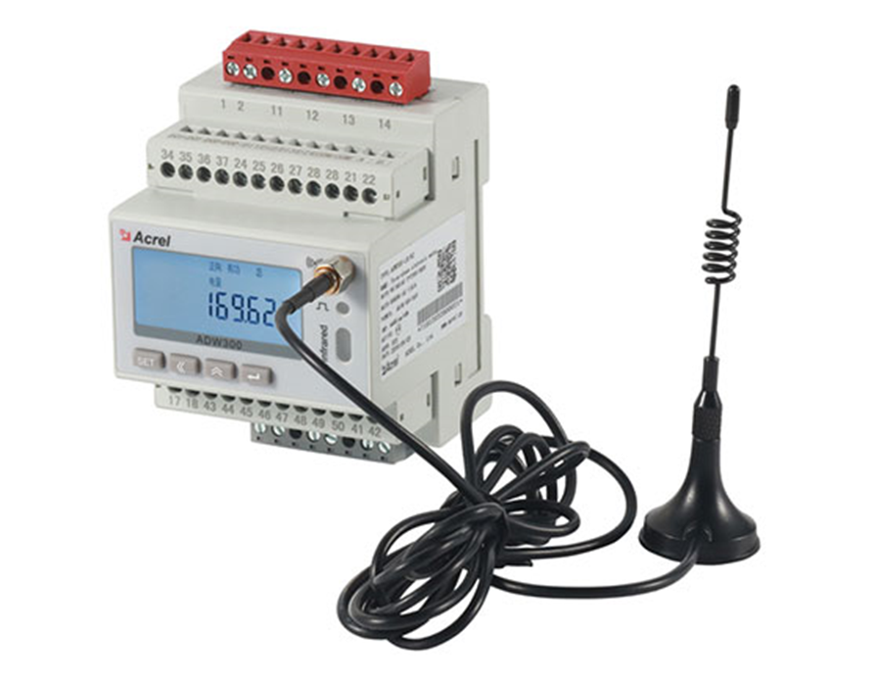
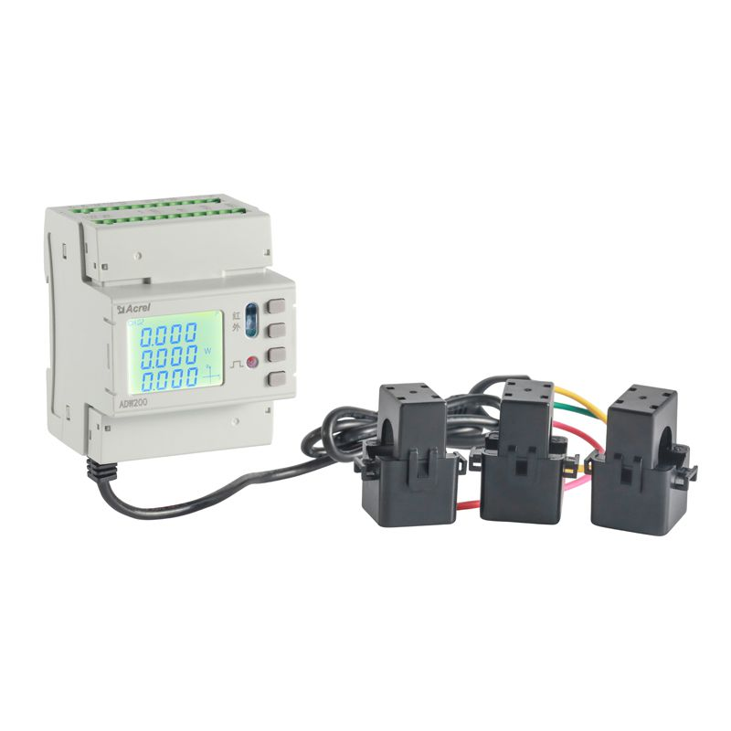



HOME
ABOUT
SOLUTIONS
PRODUCTS
PROJECTS
CONTACT US
OUR PRODUCTS
ELECTRICAL
Relay Protection
Generator ATS AMF
Energy Metering
Scada System
DC power Supply
Transformer Oil Purifier
Distribution Transformer monitoring
Temperature Monitoring/ EWS
ELECTRIC VEHICLE CHARGER (SPKLU)
AC and Small DC Charger
Ultra Fast DC Charger
ENERGY AND ENVIRONMENT MANAGEMENT
Energy Meters
Gas Meters
Water Meters
Cybel Nomag Sensor
Lora RTU
CCTV & Electronic Security
WATER TANK
TEST & MEASUREMENT TOOLS
DISTRIBUTION TRANSFORMER MONITORING
INSTALATION PHOTO
ADW300 3ph meter
w/ Built-in 4G modem
ADW201 4 Channel
3ph Cl. 1 meters
ADL400 Cl. 1
3ph meter
Meters measure Energy on Distribution transformer incoming and LVSB feeders
Energy and electrical parameters are monitored online via Cellular gateway to IoT Energy Management system
Billing and Energy-Losses reports generated can be accessed by clients through internet connection everywhere
IoT Energy Management System
AWT100 4G
Gateway Modem

Slide 27





TEMPERATURE MONITORING/ EARLY WARNING SYSTEM
HOME
ABOUT
SOLUTIONS
PRODUCTS
PROJECTS
CONTACT US
OUR PRODUCTS
ELECTRICAL
Relay Protection
Generator ATS AMF
Energy Metering
Scada System
DC power Supply
Transformer Oil Purifier
Distribution Transformer monitoring
Temperature Monitoring/ EWS
ELECTRIC VEHICLE CHARGER (SPKLU)
AC and Small DC Charger
Ultra Fast DC Charger
ENERGY AND ENVIRONMENT MANAGEMENT
Energy Meters
Gas Meters
Water Meters
Cybel Nomag Sensor
Lora RTU
CCTV & Electronic Security
WATER TANK
TEST & MEASUREMENT TOOLS
Magnetic and Strapped
Battery power
CT Induction
(No Battery)
Temperature Monitoring on Critical spots in MV panels of Substation
Sensors installed in CB fingers, busbar, cable termination, cabinets wall both magnetic and strapped attachment and wirelessly monitored by power meter (RTU)
When Spot’s temperature raise and reach the pre programmed limit RTU will send notification to Scada masters or IoT application via Internet or cellular as Early warning for users to do further action
Room Temperature
& Humidity

Slide 28


HOME
ABOUT
SOLUTIONS
PRODUCTS
PROJECTS
CONTACT US
OUR PRODUCTS
ELECTRICAL
Relay Protection
Generator ATS AMF
Energy Metering
Scada System
DC power Supply
Transformer Oil Purifier
Distribution Transformer monitoring
Temperature Monitoring/ EWS
ELECTRIC VEHICLE CHARGER (SPKLU)
AC and Small DC Charger
Ultra Fast DC Charger
ENERGY AND ENVIRONMENT MANAGEMENT
Energy Meters
Gas Meters
Water Meters
Cybel Nomag Sensor
Lora RTU
CCTV & Electronic Security
WATER TANK
TEST & MEASUREMENT TOOLS
Electric Vehicle Charger (SPKLU)
AC and Small Commercial DC Charger
Image : B_002_Swift.jpg
HUB
SMALL COMMERCIAL DC CHARGER
20/30/40kW output
200-1000VDC
5m CCS2 charging cable
Modular design with replaceable power-modules and easy one-man installation
7-inch touch display
MID meter
OCPP 1.6J (Hubject pre-integration for roaming)
Ethernet / 4G module
IP54
SWIFT 2.0
HOME & WALLBOX CHARGER
with Case B & Case C versions
RFID reader / LEDs
4-inch display(colour)
software meter
Premium metal enclosure &
glass-front-panel
OCPP 1.6J
Ethernet, wifi, 4G
RS485 / ModBus TCP
6mA+30mA
AC&DC leakage
protection IP65
Image : B_001_Hub.jpg

Slide 29



HOME
ABOUT
SOLUTIONS
PRODUCTS
PROJECTS
CONTACT US
OUR PRODUCTS
ELECTRICAL
Relay Protection
Generator ATS AMF
Energy Metering
Scada System
DC power Supply
Transformer Oil Purifier
Distribution Transformer monitoring
Temperature Monitoring/ EWS
ELECTRIC VEHICLE CHARGER (SPKLU)
AC and Small DC Charger
Ultra Fast DC Charger
ENERGY AND ENVIRONMENT MANAGEMENT
Energy Meters
Gas Meters
Water Meters
Cybel Nomag Sensor
Lora RTU
CCTV & Electronic Security
WATER TANK
TEST & MEASUREMENT TOOLS
Electric Vehicle Charger (SPKLU)
B_004_Ampax PPM
Image :B_005_PPM.jpg
Image:
B_003_Ampax.jpg
AMPAX
ULTRA FAST CHARGER
60/120/160/180/240/320kW output
150-1000 VDC
2x 5m CCS charging cable
New Enclosure Design with
42-inch video screen
Modular design with patented INJET PPC,
Easy installation and easy maintenance
10-inch touch display
MID meter
OCPP 1.6J (Hubject pre-integration for roaming)
Ethernet / 4G module
IP54
PATENTED INJET PPC (OEM)
INJET Power integrated Charger controller
Power Controller consist 5 components:
1.) Power Controller 4.) Power Modules
2.) Energy Measuring Unit 5.) Charging Gun(s)
3.) Display
Unique INJET design leads to:
• Lower hardware and maintenance costs
• Higher availability: Charging module separated from control system,
stable and safe performance, easy maintenance
• High Efficiency: Multiple module output modules in parallel
with flexible configuration, Constant power module and
smart power allocation with high charging efficiency

Slide 30



HOME
ABOUT
SOLUTIONS
PRODUCTS
PROJECTS
CONTACT US
OUR PRODUCTS
ELECTRICAL
Relay Protection
Generator ATS AMF
Energy Metering
Scada System
DC power Supply
Transformer Oil Purifier
Distribution Transformer monitoring
Temperature Monitoring/ EWS
ELECTRIC VEHICLE CHARGER (SPKLU)
AC and Small DC Charger
Ultra Fast DC Charger
ENERGY AND ENVIRONMENT MANAGEMENT
Energy Meters
Gas Meters
Water Meters
Cybel Nomag Sensor
Lora RTU
CCTV & Electronic Security
WATER TANK
TEST & MEASUREMENT TOOLS
Energy Meters
Kwh meter LoRAWAN Built-in modem
CL710K22®LoRaWAN Single phase smart energy meter is the latest developed products in Venus meter series. Certificated with MID and DLMS/COSEM, it provides an excellent and stable accuracy and performance. With built-in LoRaW AN communication module, all the operations can be done remotely from the central server, including meter billing, conguration, credit purchase, alarm events report etc
Connection Wiring | 3P4W L1L1-L2L2-L3L3-NN
Nominal voltage | 3*230V/400V
Operating voltage range | 70% ~ 130% Un
Basic current | 5A
Maximum current | 0.25 - 5(100)A
Starting current | 0.4‰Ib / 20mA
Frequency | 50 Hz ± 5%
Accuracy kWh/kVarh | Class 1 / Class 2(IEC), Class B(MID)
Pulse constant | 1000 imp/kWh, 1000 imp/kVarh
Power consumption V | <=0.75W; <=1.2VA(for each phase
Power consumption I | <=0.1VA(for each phase)
Max power consumption in voltage circuit with PLC module | 5W
Kwh meter with RS 485
Electricity meter HXE310 3ph, HXF300 3ph CT
Smart electricity has built in smart systems for recording, transmitting and monitoring electricity usage online.
kWh, kVARh and demand measurement
Remote control for open/close relay
Load profile for 15 minutes, 30 minutes, 1 hour, etc
Alerting system and Tamper detection
Real-time clock and Calendar
Nominal voltage 3×231/400V (HXE310), 3×57.7/100V-3×231/400V (HXF300)
Accuracy kWh/kVarh, Class 1 / Class 2 (IEC) (HXE310)
Class 0.5S / Class 2(IEC) (HXE300)
Limit operating temperature range -40℃- 70℃
Communication Mode : RS485 to be connected to 4G modem or LoRA RTU
HXE310
HXE310

Slide 31


HOME
ABOUT
SOLUTIONS
PRODUCTS
PROJECTS
CONTACT US
OUR PRODUCTS
ELECTRICAL
Relay Protection
Generator ATS AMF
Energy Metering
Scada System
DC power Supply
Transformer Oil Purifier
Distribution Transformer monitoring
Temperature Monitoring/ EWS
ELECTRIC VEHICLE CHARGER (SPKLU)
AC and Small DC Charger
Ultra Fast DC Charger
ENERGY AND ENVIRONMENT MANAGEMENT
Energy Meters
Gas Meters
Water Meters
Cybel Nomag Sensor
Lora RTU
CCTV & Electronic Security
WATER TANK
TEST & MEASUREMENT TOOLS
Gas Meter
Two-pipe Diaphragm gas meter G1.6, G2.5, G4 Cooperated with ZENNER International GmbH & Co. K, Atmos®LoRa Series are credit gas meters employing the Sindcon's advanced technology in IOT to build a reliable wireless communication system for gas meter.
Type | G1.6 / G2.6 / G4
Norminal flowrate (Qn) | 1.6 / 2.5 / 4 (m³/h)
Maximum flowrate (Qmax) | 2.5 / 4 / 6 (m³/h)
Minimum flowrate (Qmin) | 0.016 / 0.0025 / 0.04 (m³/h)
Maximum operating pressure | 0.5 Bar
Maximum permissible errors | ±1.5%
 | 0.1Qmax≤Q≤Qmax ±3% / ±3% / ±3%
 | Qmin≤Q≤0.1Qmin ≤2 / ≤2 / ≤2 (mbar)
Max pressure loss | 99999.998 m³/h
Display field max | 0.0002 m³/h
Display field min | 1.2 dm³
Cyclic Volume | 1.5 class
Working voltage | 4.5/6 V
Communication Protocol | Standard LoRaWAN Class A
Frequency | Can support 470MHz, 916MHz, 923MHz
TX Power | +20dBm
RX sensitivity | Down to-137dBm
Bandwith | 125KHz
Local LCD Display | Yes

Slide 32


HOME
ABOUT
SOLUTIONS
PRODUCTS
PROJECTS
CONTACT US
OUR PRODUCTS
ELECTRICAL
Relay Protection
Generator ATS AMF
Energy Metering
Scada System
DC power Supply
Transformer Oil Purifier
Distribution Transformer monitoring
Temperature Monitoring/ EWS
ELECTRIC VEHICLE CHARGER (SPKLU)
AC and Small DC Charger
Ultra Fast DC Charger
ENERGY AND ENVIRONMENT MANAGEMENT
Energy Meters
Gas Meters
Water Meters
Cybel Nomag Sensor
Lora RTU
CCTV & Electronic Security
WATER TANK
TEST & MEASUREMENT TOOLS
Water Meter (Dn.15 – Dn.25)
The Mercury®LoRa series LXSGF model is IMPELLER (turbine) water meter with build-in valve, dry type register for residential application with sizes from Dn15 to Dn25. LXSGF model consist of mechanical water meter, electric ball valve, intelligent unit (IU), with LoRaWAN wireless technique and bult-in lithium battery
Working voltage | 3.6V
Data collecting way | Dual Magnetic Sensor
Communication mode | LoRaWAN
Working frequency | 916 --- 919MHz (25mW EIRP with duty cycle of <= 1% frequency hopping or LBT)
 | 919 --- 923MHz (500mV EIRP)
Channels | 8 settable channels with bandwidth of 125kHz
TX power | 14dBm
RX sensitivities | Down to - 137dBm
Communication distance | 3km to 10km (eyesight distance in open space)
Data rate | 980bps ~ 3.125kbps (adaptive data rate)
Listen Before Talk (LBT) | Yes
Standby current | <= 40uA
Environment temperature | 0.1 ~ 50°C
Number of Data cached when network interrupted | 10

Slide 33



HOME
ABOUT
SOLUTIONS
PRODUCTS
PROJECTS
CONTACT US
OUR PRODUCTS
ELECTRICAL
Relay Protection
Generator ATS AMF
Energy Metering
Scada System
DC power Supply
Transformer Oil Purifier
Distribution Transformer monitoring
Temperature Monitoring/ EWS
ELECTRIC VEHICLE CHARGER (SPKLU)
AC and Small DC Charger
Ultra Fast DC Charger
ENERGY AND ENVIRONMENT MANAGEMENT
Energy Meters
Gas Meters
Water Meters
Cybel Nomag Sensor
Lora RTU
CCTV & Electronic Security
WATER TANK
TEST & MEASUREMENT TOOLS
Cyble Nonmag Sensor
Cyble Nonmag Sensor
Existing Water Meter
NonMag-Sensor is completely compatible with all Itron water meter and gas meter pre-equipped with the Cyble target. Easily retrofitted and installed on meters already on the field.
Working Voltage | 3.6V
Data Collecting Way | Non-magnetic Transmission
Communication mode | LoRaWAN
Working frequency | 920MHz - 925MHz
Channels | 8 settable channels with bandwith of 125kHz
TX power | 14dBm
RX sensitivities | Down to -137dBm
Communication distance | 3km to 10km (eyesight distance in open space)
Data rate | 980bps~3.125Kbps (adaptive data rate)
Listen Before Talk (LBT) | Yes
Standby current | <= 40uA
Environment temperature | -10°C - 50°C;
Number of Data cached when network interrupted | 10
Data Report Interval | 15min | 30min | 1hour | 6 hour | 8 hour | 24 hour
Battery life (year) | 5 | 6 | 7 | 8 | 8 | 8

Slide 34



HOME
ABOUT
SOLUTIONS
PRODUCTS
PROJECTS
CONTACT US
OUR PRODUCTS
ELECTRICAL
Relay Protection
Generator ATS AMF
Energy Metering
Scada System
DC power Supply
Transformer Oil Purifier
Distribution Transformer monitoring
Temperature Monitoring/ EWS
ELECTRIC VEHICLE CHARGER (SPKLU)
AC and Small DC Charger
Ultra Fast DC Charger
ENERGY AND ENVIRONMENT MANAGEMENT
Energy Meters
Gas Meters
Water Meters
Cybel Nomag Sensor
Lora RTU
CCTV & Electronic Security
WATER TANK
TEST & MEASUREMENT TOOLS
LORA COMMUNICATION DEVICE
RS 485 Lora Bridge (RTU)
LoRA Gateway
RS485-LoRa bridge is a data channel between traditional devices with RS485 output (Modbus Protocol) and LoRa gateway.
An ideal gateway to support you in your smart city, smart industry or every smart project, because it combines both the simplicity of installation a unique superior coverage and operational excellence.
Power Supply | 8-30V DC
Application | Indoor
Standby Current | 20mA
MCU | Arm® 32-bit Cortex®-M0
Frequency | 470-510MHz, 863-870MHz, 902-926MHz
TX Power | Up to +20dbm
RX Sensitivity | Down to -137dBm
Channels | 8 settable channels
Data rate | Adaptive data rate
Listen Before Talk(LBT)
LoRa Class | Both Class A & Class C
Power supply isolated & RS485 interface isolated
Compatible with IEC 61000-4-2 (ESD): Air 15kV, Contact 8kV
Sniffer for LBT (Listen Before Talk)
 | Built-in with hight rejection SAW filters
Rx Sensitivity | -141 dBm (SF12)
TX Power | configurable from 5dBm to 27dBm
 | Range -40°C +60°C
Humidity | 95%
Size | 265 x 165 x 100 mm
Weight | 1,4kg (mounting kit included)
 | Spectrum analysis compliant
 | Backup batteries to allow the clean shut down of applications in case of power cut
Casing | IP6 Alu (Black), Polycarbonate (Front), Inox (mounting kit)
 | Surge protection of the RF LoRa link (option)
CPU | ARM Cortex A9
 | DDRAM 256MB
 | 8GB eMMC (6GB available for user)
Outdoor
Indoor

Slide 35












PT. SINERGI RODIKA UTAMA
HOME
ABOUT
SOLUTIONS
PRODUCTS
PROJECTS
CONTACT US
OUR PRODUCTS
ELECTRICAL
Relay Protection
Generator ATS AMF
Energy Metering
Scada System
DC power Supply
Transformer Oil Purifier
Distribution Transformer monitoring
Temperature Monitoring/ EWS
ELECTRIC VEHICLE CHARGER (SPKLU)
AC and Small DC Charger
Ultra Fast DC Charger
ENERGY AND ENVIRONMENT MANAGEMENT
Energy Meters
Gas Meters
Water Meters
Cybel Nomag Sensor
Lora RTU
CCTV & Electronic Security
WATER TANK
TEST & MEASUREMENT TOOLS
CCTV & Electronic Security
Indoor IP camera
BURGLAR ALARM
ACCESS CONTROL
Indoor IP camera
CONVEX MIRROR
GUARD TOUR PATROL
Network Video Recorder
TRIPOD & BARRIER GATE
XRAY AND METAL DETECTOR
Jl. Jalur Sutera Timur Kav. 6A No. 16 Alam Sutera, Tangerang 15144, BANTEN
Telp/ Fax 021 22352886 Email : sinergi.rodika@gmail.com

Slide 36



WATER TANK
HOME
ABOUT
SOLUTIONS
PRODUCTS
PROJECTS
CONTACT US
OUR PRODUCTS
ELECTRICAL
Relay Protection
Generator ATS AMF
Energy Metering
Scada System
DC power Supply
Transformer Oil Purifier
Distribution Transformer monitoring
Temperature Monitoring/ EWS
ELECTRIC VEHICLE CHARGER (SPKLU)
AC and Small DC Charger
Ultra Fast DC Charger
ENERGY AND ENVIRONMENT MANAGEMENT
Energy Meters
Gas Meters
Water Meters
Cybel Nomag Sensor
Lora RTU
CCTV & Electronic Security
WATER TANK
TEST & MEASUREMENT TOOLS
Zincalume Steel Liner Australian Technology
Local Content TKDN 34.89%
Long life time (10 years warranty)
Harsh condition earth quake and wind resistance 317kmh
Easy fast fabrication, delivery and installation
Concrete Base or Steel Platform
Permanent/ Temporary Installation
INSIDE
• Standard PVC Liner 700gsm
• Puncture Resistance 1022 N
• Welding strength – 57 N/mm
• AS4020 potable water
• Temperature up to 60 degree
APPLICATION
1. Potable Water (Drinking water)
2. Raw Water (Deep well/ river)
3. Permeate Water (RO)
4. Hypersaline
5. Waste water / Sewage
6. Aquaculture (Fishery)
7. Agriculture
8. Disaster Quick Respond Facility
Nozzle (Custom)

Slide 37











HOME
ABOUT
SOLUTIONS
PRODUCTS
PROJECTS
CONTACT US
OUR PRODUCTS
ELECTRICAL
Relay Protection
Generator ATS AMF
Energy Metering
Scada System
DC power Supply
Transformer Oil Purifier
Distribution Transformer monitoring
Temperature Monitoring/ EWS
ELECTRIC VEHICLE CHARGER (SPKLU)
AC and Small DC Charger
Ultra Fast DC Charger
ENERGY AND ENVIRONMENT MANAGEMENT
Energy Meters
Gas Meters
Water Meters
Cybel Nomag Sensor
Lora RTU
CCTV & Electronic Security
WATER TANK
TEST & MEASUREMENT TOOLS
HI TESTER CM - 3286
Check Harmonics and PF
20 -1000 A AC
150 - 600 V AC
3 - 1200 kW
Freq, Reactivity, phase angle
Bluetooth connection
THERMAL CAMERA FLIR EX
Measuring temperatures from
-20°C to 550°C
MSX® technology (thermal imaging)
Wi-Fi connectivity Android/ IOS
IR Resolution :
E4 80 × 60 (4,800 pixels)
E5-XT 160 × 120 (19,200 pixels)
E6-XT 240 × 180 (43,200 pixels)
E8-XT 320 × 240 (76,800 pixels)
POWER QUALITY
ANALYZER PQ3198, PQ3100
Class A international standards
Basic voltage accuracy of ±0.1%
High-voltage, wideband performance
Two-circuit measurement
GPS time synchronization
Voltage ±0.1% of nominal voltage
20 kV Amp stick & Volt stick
20 kV Voltage
Detector
Grounding sets
Telescopic stick
Plastic seals (Segel)
Safety Equipment

Slide 38


HOME
ABOUT
SOLUTIONS
PRODUCTS
PROJECTS
CONTACT US
PROJECT REFERENCE
Relay Protection
Generator ATS AMF
Energy Metering
Scada System
DC power Supply
Transformer Oil Purifier
Street Lamps and Warehouse
CCTV and Metal Detectors
PROJECT REFERENCE
Relay Protection
Generator ATS AMF
Energy Metering
Scada System
DC power Supply
Transformer Oil Purifier
Street Lamps and Warehouse
CCTV and Metal Detectors
PROTECTION RELAYS
1. Installation 10 unit LCD relays MICOM P543 for 5 lines of 150 kV Transmission and integration to existing SAS Location GI PARIT BARU, GI SENGGIRING, GI PLTU BENGKAYANG, GI SINGKAWANG
PT PLN UP3B Sistem Kalbar, Year : 2021-2022
2. Supply and installation Over Current Relay Micom P143 PT GEO DIPA ENERGI Pengalengan, Year 2023
3. Supply Protection Relay MiCOM P127 Gardu Hubung PT PLN (Persero) UP3 Tanjungpinang, Year 2022
4. Installation 20 unit Relay Proteksi 20 kV MICOM P123 and P127 in 20 location, PT PLN UP2D Riau, Year 2021
3. Installation Reverse Power Protection Relay Easergy P5 5 unit
User : PT PLN Batam , Year 2021
Line Differential Relay – UP3B Kalbar

Slide 39




Generator ATS Backup Power Supply
HOME
ABOUT
SOLUTIONS
PRODUCTS
PROJECTS
CONTACT US
PROJECT REFERENCE
Relay Protection
Generator ATS AMF
Energy Metering
Scada System
DC power Supply
Transformer Oil Purifier
Street Lamps and Warehouse
CCTV and Metal Detectors
1. Backup Power Supply for Substation
User : PT PLN UPK Tambora NTB, year 2023-2024
Project : PENGADAAN GENSET DAN PEMBANGUNAN
RUMAH GENSET TAMBORA
Installation : 11 Generator Cummins 100 kVA and ATS AMF and Cummins 100 kVA in 11 substation in PLN NTB 150 kV System
2. INSTALLATION BACKUP POWER SUPPLY FOR SUBSTATION
PT PLN UP3B KALIMANTAN BARAT
User : PT PLN UP3B Kalimantan Barat, Year 2022
Project : PENGADAAN DAN PEMASANGAN BACKUP SUPPLY AC GARDU INDUK UP3B KALBAR LOKASI GI TERSEBAR PT PLN (Persero) UP3B SISTEM KALBAR
Installation : 5 Generator Cummins 100 kVA and ATS AMF and supporting building in 11 substation in PLN NTB 150 kV System
2. SUPPLY GENERATOR SET
User : PT PLN UP3 Sumbawa, year 2023
Project :PENGADAAN GENSET UNTUK MENDUKUNG PERSIAPAN PEMILU SERENTAK 2024
Material : 5 unit Genset Mitzumi 20 kVA
Genset AMF PLN Tambora NTB
Genset AMF PLN UP3B Kalbar

Slide 40


HOME
ABOUT
SOLUTIONS
PRODUCTS
PROJECTS
CONTACT US
ENERGY METERS
1. Installation 20 units Energy Meters EDMI MK6E Class 0.2s and supporting devices in 20 locations PT PLN Nusantara Power Kapuas Kalimantan Barat , Year 2023-2024
2. Installation Multi channel Meter for Online Losses Monitoring (OLM) Distribution Transformer PT. PLN (Persero) UP3 Bangka, Year 2023
3. Installation 20 unit Kwh meter EDMI MK6E Class 0.2s
PT PLN (Persero) UP3B Sistem Kalbar, Year 2021
4. Installation 10 Edmi MK6E MK6N and Schneider ION in Feeders
substation PLN Batam, Year : 2022
PROJECT REFERENCE
Relay Protection
Generator ATS AMF
Energy Metering
Scada System
DC power Supply
Transformer Oil Purifier
Street Lamps and Warehouse
CCTV and Metal Detectors
Kwh Class 0.2s PLN UPK Kapuas

Slide 41




Scada System
HOME
ABOUT
SOLUTIONS
PRODUCTS
PROJECTS
CONTACT US
PROJECT REFERENCE
Relay Protection
Generator ATS AMF
Energy Metering
Scada System
DC power Supply
Transformer Oil Purifier
Street Lamps and Warehouse
CCTV and Metal Detectors
1. Installation Gateway and Scada Integration
User : PT PLN UPK Timor NTT, year 2023
Projects : PENGADAAN SETUP SCADA SYSTEM PLTU BOLOK
PT PLN(PERSERO) UNIT PELAKSANA PEMBANGKITAN TIMOR
Installation : SCADA Gateway, Dual Master : Unlimited Gateway, Protocol Modbus to IEC 104 and Setting & Parameterization Modbus TCP/IP to IEC-104, Gateway Configuration & Data Mapping on existing Scada Master
2 Upgrade Scada System
User : PT PLN (UP2D Riau, year 2023
Project : Pengadaan Perbaikan Scada GH Perawang, GH Bintan Center dan GI Garuda Sakti lokasi PT PLN (Persero) UP2D Riau
Installation Remote IO Extender Digital Input output (7 DI 8DO), Extender Digital Output (8 DO) and supporting accessories
Scada UPK Timor NTT
Scada upgrade PLN UP2D Riau

Slide 42




Scada System
HOME
ABOUT
SOLUTIONS
PRODUCTS
PROJECTS
CONTACT US
3. Installation Keypoint Modem and Scada integration
User : PT PLN (Persero) UP2D Lampung, year 2019
Project : PENGADAAN DAN INTEGRASI MODEM SCADA KEYPOINT TAHAP I 2019, PT PLN (PERSERO)UNIT PELAKSANA PENGATUR DISTRIBUSI LAMPUNG
Installation 47 location GSM Modem Router and Integration to existing Scada
4. Installation Keypoint Modem and Scada integration
User : PT PLN (Persero) UP2D Sulselrabar Makassar, Year 2020
Project : PENGADAAN MODEM GPRS 39 TITIK KEYPOINT SCADA UP2D MAKASSAR
Installation 39 location GSM Modem Router and Integration to existing Scada
5. Installation of Multichannel Meter for Distribustion Transformer
User : PT PLN (Persero) UID Bangka Belitung, Year 2023
Project : Pengadaan kWhmeter Multichannel untuk perhitungan loses Trafo dan PHBTR
Material : Multichannel meter with Online application with Clouds IOT
PROJECT REFERENCE
Relay Protection
Generator ATS AMF
Energy Metering
Scada System
DC power Supply
Transformer Oil Purifier
Street Lamps and Warehouse
CCTV and Metal Detectors
Modem key point UP2D Makassar
Transformer Online monitoring
PLN Bangka Belitung

Slide 43




HOME
ABOUT
SOLUTIONS
PRODUCTS
PROJECTS
CONTACT US
RECTIFIERS AND BATTERIES
1. Installation 20 Set Rectifier 48 VDC, Inverter 220 VAC and
Battery Enermild in 20 GH, PT PLN UP2D RIAU, Year : 2023
2. Replacement Rectifier 48 VDC GI Mangkunegaran dan
GI Kebasem, PT. PLN (Persero) UP2B Jateng & DIY, Year 2023
3. Installation of Rectifier 80 A GITET Pedan Battery and UPS 2000VA
PT. PLN (Persero) UP2B Jateng & DIY, Year 2023
4. Supply and installation Rectifier 48 VDC PT PLN (Persero) UP2B Sistem Minahasa, Year 2023
5. Supply Battery LiFePO4 for Keypoint LBS PT PLN (Persero) UP2D Makassar Year 2023
6. Supply Battery LiFEPO4 for Keypoint PT PLN (Persero) UP2D
Lampung, Year 2023
PROJECT REFERENCE
Relay Protection
Generator ATS AMF
Energy Metering
Scada System
DC power Supply
Transformer Oil Purifier
Street Lamps and Warehouse
CCTV and Metal Detectors
Rectifier Inverter and Battery PLN UP2D Riau
Rectifier and Battery PLN UP2B Jateng

Slide 44



HOME
ABOUT
SOLUTIONS
PRODUCTS
PROJECTS
CONTACT US
Transformer Oil Purifier
PROJECT REFERENCE
Relay Protection
Generator ATS AMF
Energy Metering
Scada System
DC power Supply
Transformer Oil Purifier
Street Lamps and Warehouse
CCTV and Metal Detectors
1. Transformer Oil Purifier for Substation 2000 LH and 4000 LH
User : PT PLN (Persero) UP2K Maluku, year 2019
Project : Supply and commissioning Mesin Treatment Oli Trafo (Oil Purifikasi)
2. Transformer Oil Purifier 4000 LH
User : PT PLN (Persero) UPDK Tambora NTB, year 2018
3. Transformer Oil Purifier 4000 LH
User : PT PLN (Persero) APDP Sistem Kalbar, year 2013
PLN Maluku 2019
PLN NTB 2018

Slide 45



HOME
ABOUT
SOLUTIONS
PRODUCTS
PROJECTS
CONTACT US
PROJECT REFERENCE
Relay Protection
Generator ATS AMF
Energy Metering
Scada System
DC power Supply
Transformer Oil Purifier
Street Lamps and Warehouse
CCTV and Metal Detectors
Street Lamps and Warehouse
1.Installation Lampu Penerangan jalan Umum (PJU)
User : Pemda Ogan Ilir Sumatera Selatan, year 2022
Installation : electrical and civil works PJU
2. Renovation of Oriflame Warehouse - Bogor
User : PT PT Orindo alam ayu (oriflame) , year 2016
Installation : Electrical, civil and Chiller for Warehouse
PJU dan Solar Cell Pemda
Renovation of Warehouse Oriflame Bogor

Slide 46




CCTV and Metal Detectors
HOME
ABOUT
SOLUTIONS
PRODUCTS
PROJECTS
CONTACT US
PROJECT REFERENCE
Relay Protection
Generator ATS AMF
Energy Metering
Scada System
DC power Supply
Transformer Oil Purifier
Street Lamps and Warehouse
CCTV and Metal Detectors
1. Xray Scanner and Walkthrough Metal Detector
User : PT Bayer Indonesia, Year 2023
Projects : Supply and installation 2 units X Ray Scanner and 2 WTMD
2. CCTV and Access Control
User : PT Adaro Balikpapan, Year 2021
Project : Supply and installation CCTV and Access Control for ADARO office and sites in Balikpapan
Xray Scanner and WTMD PT Bayer Indonesia
CCTV and Access Control PT Adaro Balikpapan

